Slide 1
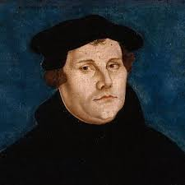
5TH GENERATION OF THE CHURCH
NAME: SARDIS
MEANING: THE ESCAPED ONES
PERIOD: A.D 1517 – A.D 1750
ANGEL: MARTIN LUTHER
CHARACTER:
THE BREAKING OUT OF THE CATHOLIC SYSTEM
(THE BEGINING OF THE RESTORATION MOVE OF GOD)

Slide 2
5TH GENERATION OF THE CHURCH
NAME: SARDIS
MEANING: THE ESCAPED ONES
PERIOD: A.D 1517 – A.D 1750
ANGEL: MARTIN LUTHER
NOTABLE OCCURRENCES:
(1) THE PROTESTANT REFORMATION (OCT. 31, 1517)
(2) THE 3RD EXODUS
(3) THE BEGINING OF THE SHOUT AND THE MIDNIGHT CRY
(MATT. 25 : 6, 1 THES. 4 : 16)
(4) THE BLADE IN THE CORN PLANT GROWTH (MARK 4 : 26)
(5) THE END OF THE DARK AGES IN SCIENCE AND ACADEMICS
(6) THE RISE OF MANY MORE DENOMINATIONS
(7) THE TRANSLATION OF THE BIBLE TO DIFFERENT LANGUAGES

Slide 3
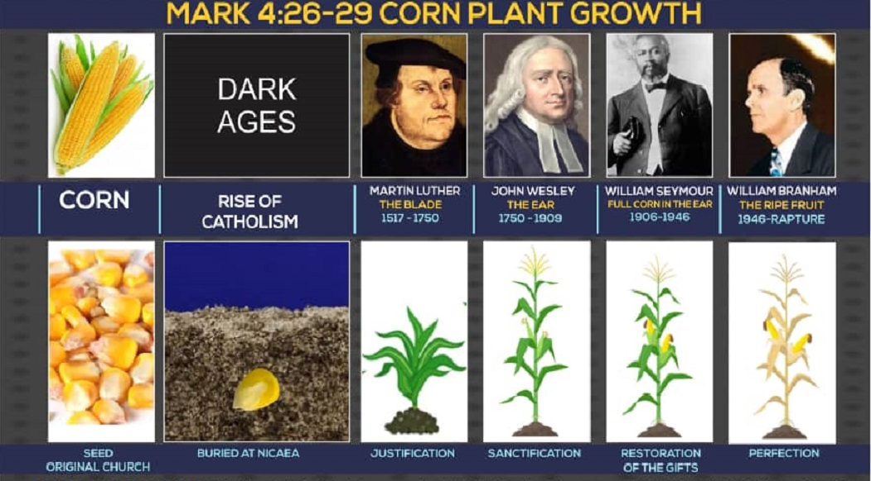

Slide 4
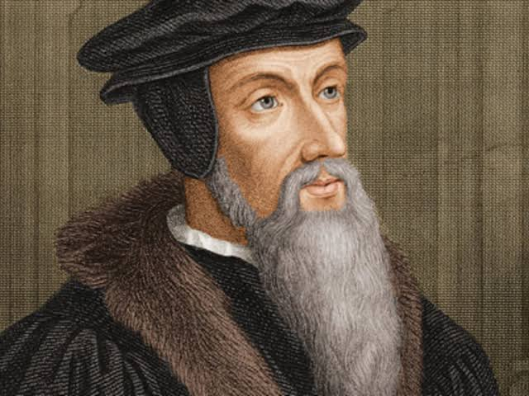
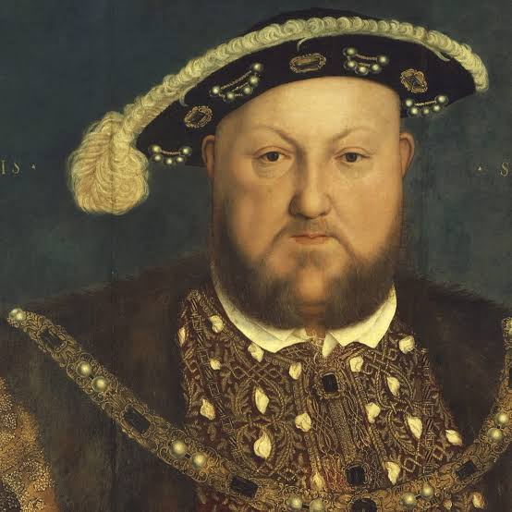
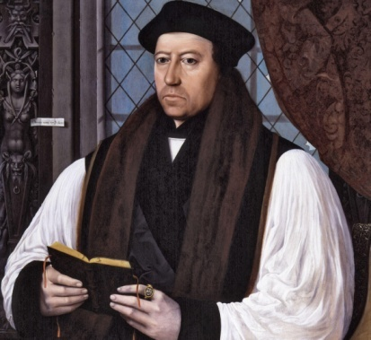
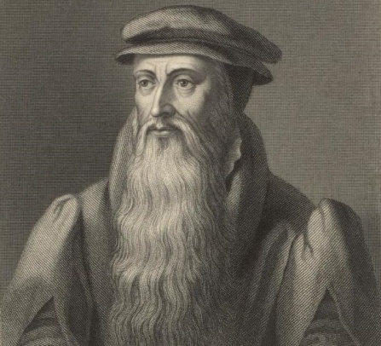
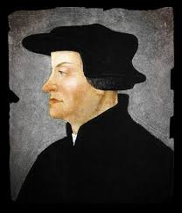
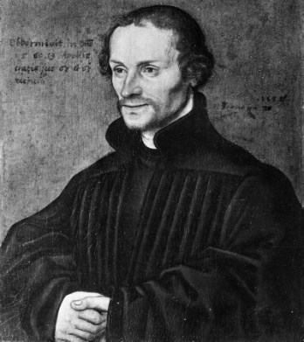
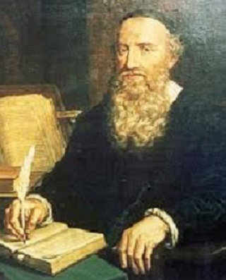
REFORMERS
JOHN CALVIN HENRY VIII THOMAS CRANMER
HULDRYCH
ZWINGLI
PHILIPP MELANCHTHON
MENNO SIMONS
JOHN KNOX

Slide 5
THE 5 SOLAS OF THE REFORMATION
SOLA FIDE - BY FAITH ALON
SOLA SCRIPTURA - BY SCRIPTURE ALONE
SOLA GRATIA - BY GRACE ALON
SOLA CHRISTUS - THROUGH CHRIST ALONE
SOLA DEO GLORIA - GLORY TO GOD ALONE

