Slide 1
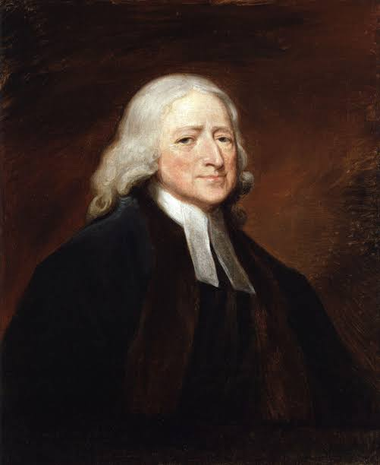
6TH GENERATION / AGE OF THE CHURCH
NAME: PHILADELPHIA
MEANING: BROTHERLY LOVE
PERIOD: A.D 1750 – A.D 1906
ANGEL: JOHN WESLEY
CHARACTER:
THE GREAT MISSIONARY AGE
(THE EVANGELICAL AGE)

Slide 2
6TH GENERATION / AGE OF THE CHURCH
NAME: PHILADELPHIA
MEANING: BROTHERLY LOVE
PERIOD: A.D 1750 – A.D 1906
ANGEL: JOHN WESLEY
The word “WORLD” as used in the Bible
Signifies different things:
(1) WORLD – MANKIND (JOHN 3 : 16)
(2) WORLD – THE WHOLE EARTH (MARK 16 : 15)
(3) WORLD – WORLDLY SYSTEM (1 JOHN 2 : 15)
(4) WORLD – INHABITED EARTH (THE OLD ROMAN EMPIRE) (LUKE 2 : 1)
(5) WORLD – AGE

Slide 3
6TH GENERATION / AGE OF THE CHURCH
NAME: PHILADELPHIA
MEANING: BROTHERLY LOVE
PERIOD: A.D 1750 – A.D 1906
ANGEL: JOHN WESLEY
NOTABLE OCCURRENCES:
(1) THE RISE OF THE EVANGELICALS
(2) THE RESTORATION OF THE 2ND WORK OF GRACE
(3) THE EVANGELIZATION OF THE WHOLE WORLD
(4) THE RISE OF BIBLE SCHOOLS

Slide 4
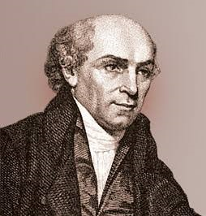
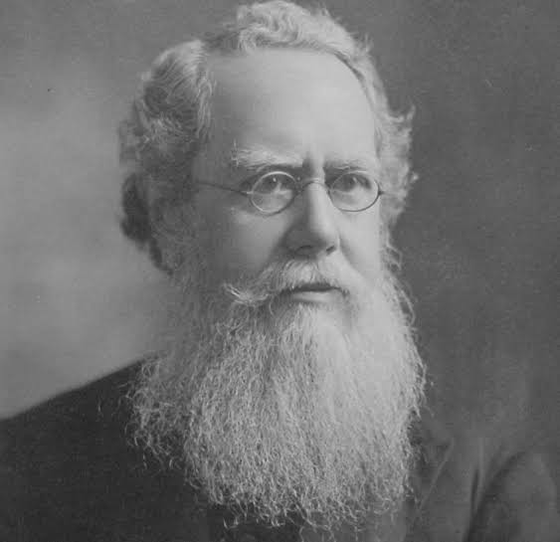
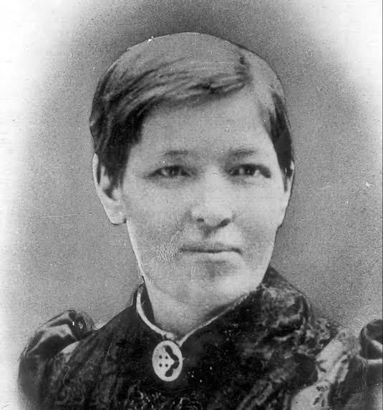
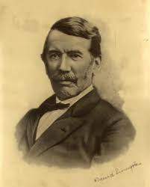
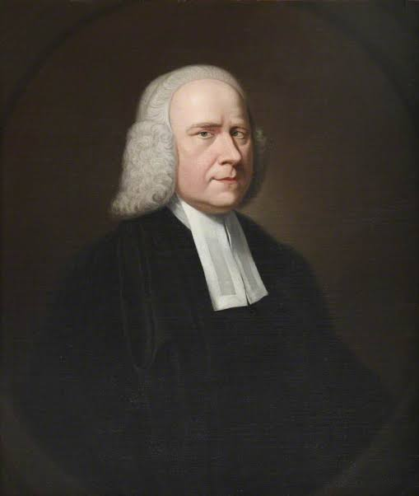
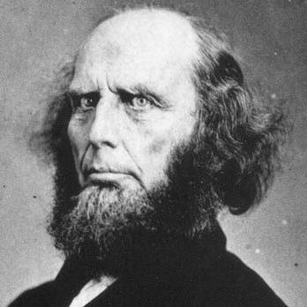
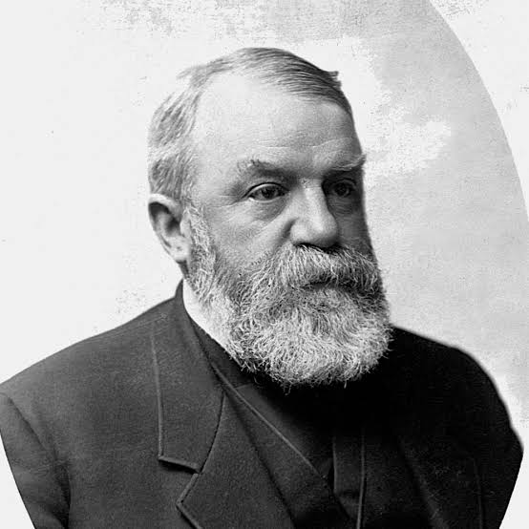
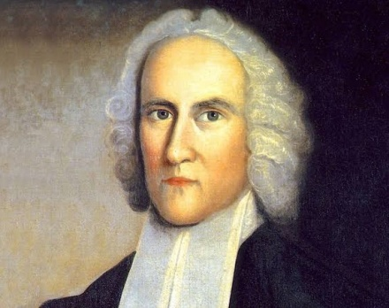
NOTABLE EVANGELISTS
WILLIAM CAREY HUDSON TAYLOR MARY SLESSOR DAVID LIVINGSTONE
CHARLES
FINNEY
JONATHAN EDWARDS
GEORGE WHITEFIELD
DL MOODY

Slide 5
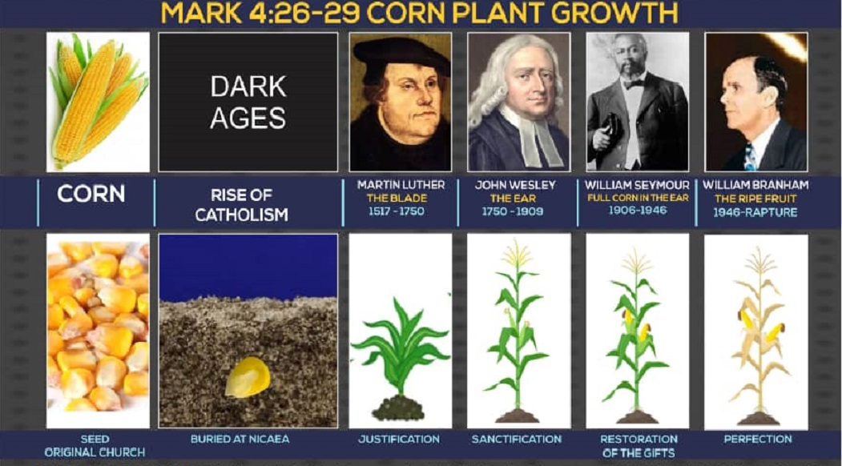

Slide 6
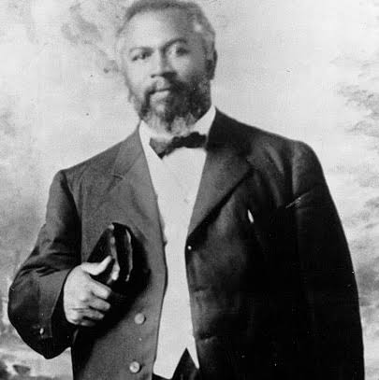
7TH GENERATION / AGE OF THE CHURCH
NAME: LAODICEA
MEANING: PEOPLE’S RIGHT
PERIOD: A.D 1906 – RAPTURE
ANGEL: WILLIAM SEYMOUR
CHARACTER:
THE INSENSITIVE AGE
(THE LUKEWARM GENERATION)

