Slide 1
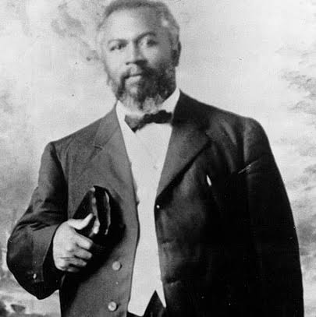
7TH GENERATION / AGE OF THE CHURCH
NAME: LAODICEA
MEANING: PEOPLE’S RIGHT
PERIOD: A.D 1906 – RAPTURE
ANGEL: WILLIAM SEYMOUR
CHARACTER:
THE LUKEWARM GENERATION

Slide 2
7TH GENERATION / AGE OF THE CHURCH
NOTABLE OCCURRENCES:
(1) THE GREAT AZUSA REVIVAL
(2) THE RESTORATION OF THE GIFTS
(3) THE HEALING REVIVALS
(4) THE RISE OF PROSPERITY GOSPEL
(5) THE REUNITING OF THE PROTESTANTS WITH
THE CATHOLIC
(6) THE ECUMENICAL MOVEMENTS
(7) THE IMPERSONATION OF GIFTS
(8) ADVANCEMENTS IN PREACHING THE GOSPEL
(9) THE PERFECTION OF THE CHURCH
(10) THE AGE OF RAPTURE
GENERATION NAME:
LAODICEA
MEANING:
PEOPLE’S RIGHT
PERIOD:
A.D 1906 – RAPTURE
ANGEL:
WILLIAM SEYMOUR

Slide 3
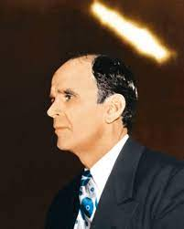
THE MERCHANTMAN OF RIGHTEOUSNESS (REVELATION 3 : 18)
WILLIAM MARRION BRANHAM

Slide 4
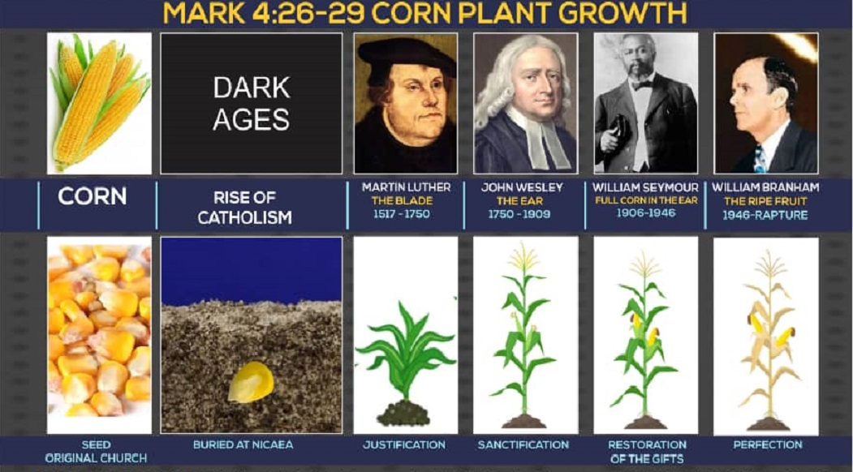

Slide 5
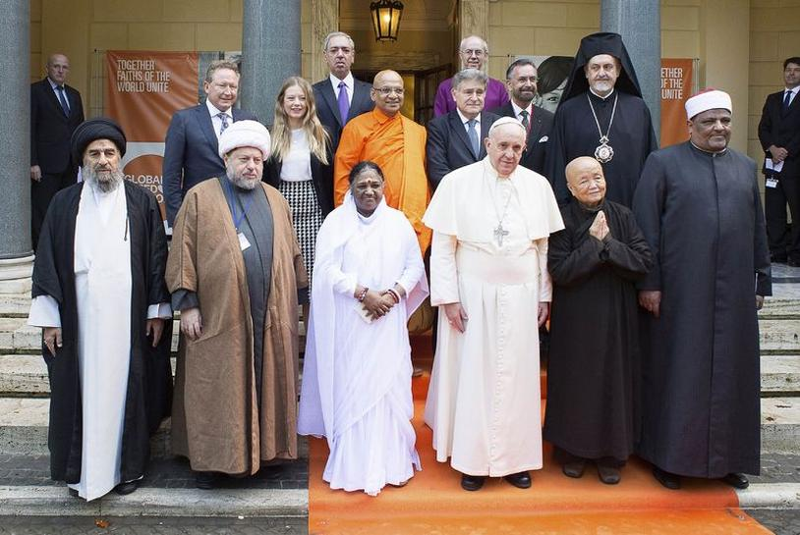
POPE AND ONE WORLD RELIGION LEADERS

Slide 6
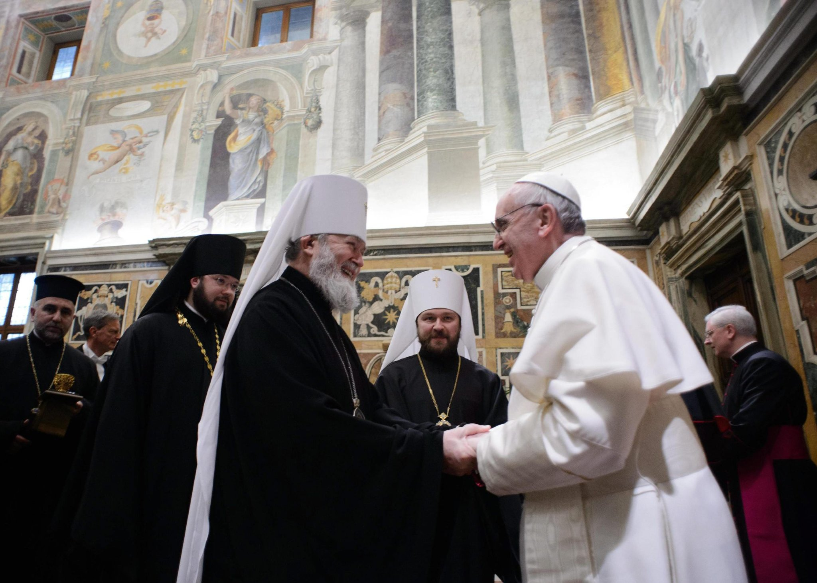
POPE AND ONE WORLD RELIGION LEADERS

Slide 7
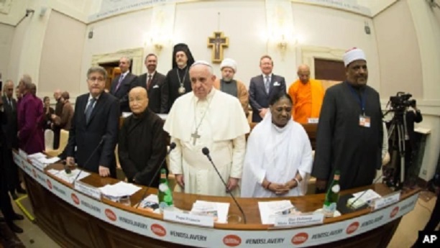
POPE AND ONE WORLD RELIGION LEADERS

Slide 8
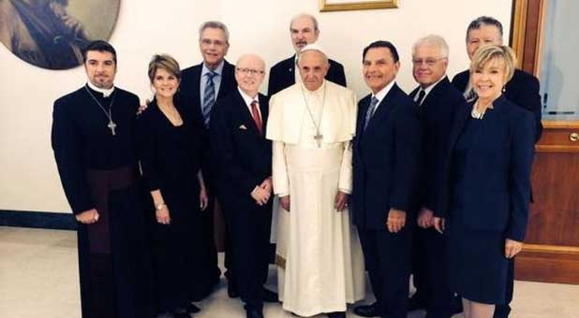
PROTESTANT LEADERS WITH THE POPE

Slide 9
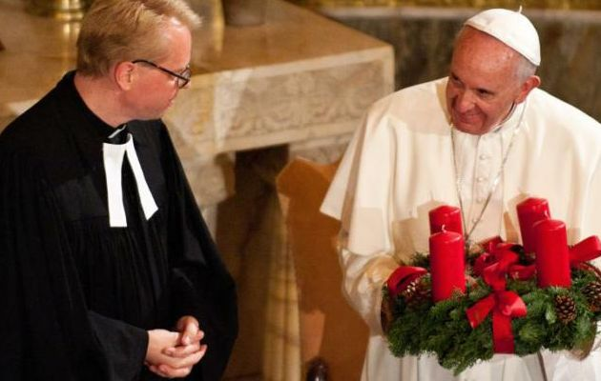
LUTHERAN LEADER WITH THE POPE

