Slide 1
4TH GENERATION OF THE CHURCH
NAME: THYATIRA
MEANING: DOMINATING WOMAN
PERIOD: A.D 606 – A.D 1517
ANGEL: COLUMBA
INTRODUCTION OF CHRIST:
“THE SON OF GOD WHO HATH HIS EYES LIKE A FLAME OF FIRE AND HIS FEET LIKE FINE BRASS”
CHARACTER:
THE DOMINANCE AND TRIUMPHING OF THE CATHOLIC CHURCH

Slide 2
4TH GENERATION OF THE CHURCH
NAME: THYATIRA
MEANING: DOMINATING WOMAN
PERIOD: A.D 606 – A.D 1517
ANGEL: COLUMBA
KEY POINTS:
(1) THE WOMAN JEZEBEL (REV. 2 : 20)
(2) JEZEBEL THE PROPHETESS IS TEACHING (REV. 2 : 20)
(3) HER FORNICATION AND ADULTERY (REV. 2 : 21 - 22)
(4) GREAT TRIBULATION (REV. 2 : 22)
(5) DEATH HER REWARD (REV. 2 : 23)
(6) “THE REST” (REV. 2 : 24)
(7) THE DEPTHS OF SATAN (REV. 2 : 24)

Slide 3
4TH GENERATION OF THE CHURCH
NAME: THYATIRA
MEANING: DOMINATING WOMAN
PERIOD: A.D 606 – A.D 1517
ANGEL: COLUMBA
NOTABLE OCCURENCES IN THYATIRA:
(1) THE DARK AGES (SATAN’S MILLENIUM)
(2) THE INQUISITION (68 MILLION CHRISTIANS KILLED)
(3) THE TRANSITION FROM IMPERIAL ROME TO ECCLESIASTICAL ROME

Slide 4
4TH GENERATION OF THE CHURCH
NAME: THYATIRA
MEANING: DOMINATING WOMAN
PERIOD: A.D 606 – A.D 1517
ANGEL: COLUMBA
REWARD FOR OVERCOMERS:
(1) POWER OVER NATIONS
(REV. 1 : 6, MATTHEW 19 : 27 – 29, LUKE 19 : 11 – 27, REV. 3 : 21,
ISAIAH 65 : 17 - 25)
(2) THE MORNING STAR (REV. 22 : 16, 2 PETER 1 : 19)

Slide 5
REWARD FOR OVERCOMERS:
(1) POWER OVER NATIONS
(REV. 1 : 6, MATTHEW 19 : 27 – 29, LUKE 19 : 11 – 27, REV. 3 : 21,
ISAIAH 65 : 17 - 25)
(2) THE MORNING STAR (REV. 22 : 16, 2 PETER 1 : 19)
3 BASIC MYSTERIES
(1) THE MYSTERY OF INIQUITY (2 THES. 2 : 7)
(2) THE MYSTERY OF GODLINESS (2 TIMOTHY 3 : 16)
(3) THE MYSTERY OF BABYLON (REV. 17 : 5)

Slide 6
THE WOMAN JEZEBEL (REV. 2 : 20)
NOTE: THE BOOK IS SYMBOLIC
THE WOMAN JEZEBEL REFERS TO A CHURCH, BECAUSE THE CHURCH IS
LIKENED TO A WOMAN.
SO IT MEANS A CHURCH WITH THE SPIRIT / CHARACTER OF JEZEBEL
CHARACTER OF JEZEBEL
(1) SHE BROUGHT IDOLATRY TO ISRAEL (1 KINGS 16 : 29 – 30)
(2) SHE CORRUPTED AHAB AND MADE HIM EVIL (1 KINGS 21 : 25)
(3) SHE KILLED THE PROPHETS OF THE LORD (1 KINGS 18 : 13)
(4) SHE KILLED TRUE BELIEVERS (1 KINGS 21 : 5 -16)
MEANING:
THIS WOMAN (A CHURCH) WILL BE AS WICKED AS JEZEBEL

Slide 8
With the idea of gods and goddesses associated with various events in life now established in pagan Rome, it was but another step for these same concepts to finally be merged into the church of Rome. Since converts from paganism were reluctant to part with their “gods” – unless they could find some satisfactory counterpart in Christianity – the gods and goddesses were renamed and called “saints.”The old idea of gods associated with certain occupations and days has continued in the Roman Catholic belief in saints and saints’ days, as the following table shows.
Actors St. Genesius August 25
Architects St. Thomas December 21
Astronomers St. Cominic August 4
Athletes St. Sebastain January 20
Bakers St. Elizabeth November 19

Slide 9
Printers St. John of God March 6
Sailors St. Brendan Mays 16
Scientists St. Albert November 15
Singers St. Gregory March 12
Steel Workers St. Eliguis December 1
Students St. Thomas Aquinas March 7
Surgeons S.S. Cosmas & Damian September 27i
Tailors St. Boniface June 5
Tax collectors St. Matthew September 21
The Roman Catholic church also has saints for the following: barren women (St. Anthony), beer drinkers (St. Nicholas), children (St. Dominic), domestic animals (St. Anthony), emigrants (St. Francis), lovers (St. Raphael), old .... Maids (St. Andrew), poor (St. Lawrence), pregnant women (St. Gerard), television (St. Clare), to apprehend thieves (St. ...ervase), to obtain a husband (St. Joseph), to obtain a wife (St. Anne), to find lost articles (St. Anthony), etc.

Slide 10
Catholics are taught to pray to certain “saints” for help with the following afflictions: arthritis (St. James), bite of dogs (St. Hubert), bite of snakes (St. Hilary), blindness (St. Raphael), cancer (St. Peregrine), cramps (St. Murice), deafness (St. Cadoc), disease of breast (St. Agatha), disease of eyes (St. Lucy)

Slide 12
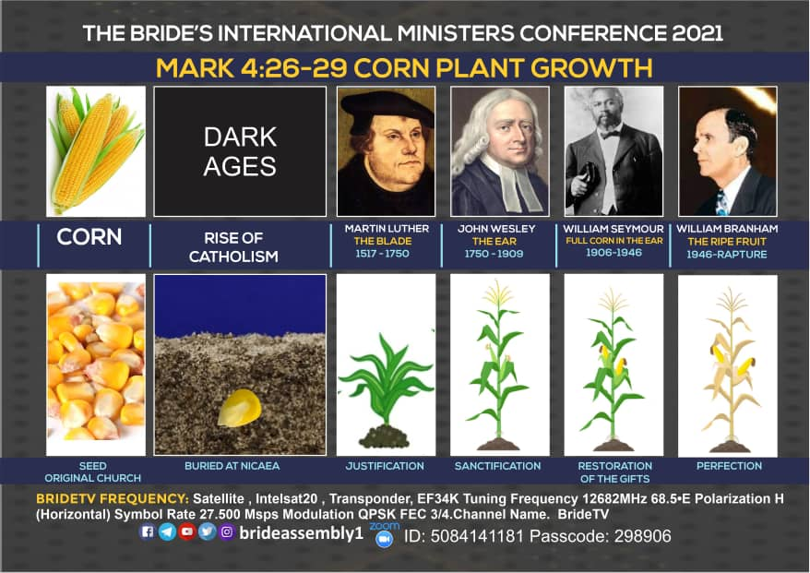

Slide 13
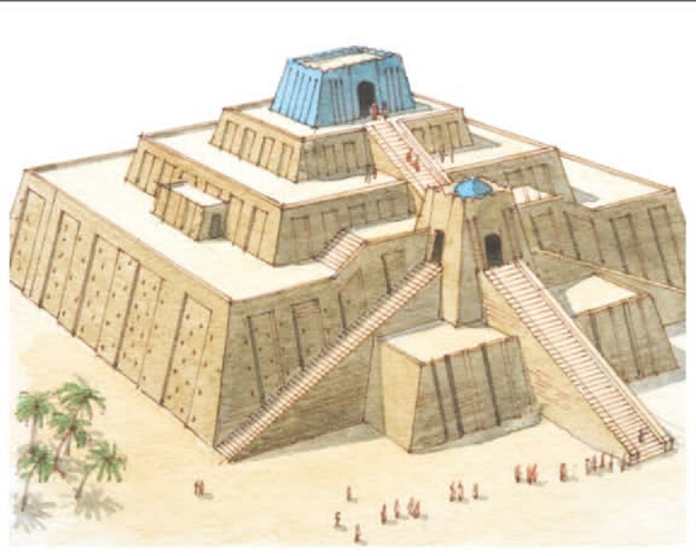

Slide 15
PAGAN PRACTICES IN THE CATHOLIC CHURCH:
A.D. 310 The sign of the cross began
A.D. 320 Wax candles were introduced
A.D. 325 Foundation laid for the trinity concept at Nicea
A.D. 375 The veneration of angels and dead saints began
A.D. 394 The worship of Mary invented
A.D. 500 Priests began to dress differently from the people
A.D. 600 The Latin language for prayer and worship in churches
was imposed by Gregory I. prayers were directed to Mary
or to dead saints.
A.D. 650 Feast in honour of the virgin Mary began
A.D. 709 Kissing of the pope’s feet began
A.D. 750 The temporal power of the pope was invented

Slide 16
PAGAN PRACTICES IN THE CATHOLIC CHURCH:
A.D. 788 Adoration of Mary and dead; saints began; worship of
the cross, of images and relics was invented.
A.D.850 Holy water, mixed with a pinch of salt and blessed by the
priest with bell, book and candle was invented.
A.D. 890 Veneration OF St. Joseph, the husband of Mary, began.
A.D. 965 Baptism of bells was instituted.
A.D. 995 Canonization of dead saints was first invented by Pope
John V.
A.D. 998 Fasting on Fridays and during the lent was imposed
A.D. 1079 The celibacy of the priesthood was decreed
A.D. 1090 The rosary was introduced

Slide 17
PAGAN PRACTICES IN THE CATHOLIC CHURCH:
A.D. 110 The mass was developed gradually as a sacrifice and
attendance was made obligatory
A.D. 1184 The inquisition of heretics was instituted
A.D. 1190 The sale of indulgences began
A.D. 1200 The water was substituted for bread in the Lord’s supper
A.D. 1215 The dogma of transubstantiation was invented and the
confession of sins to the priest at least once a year was
enforced
A.D. 1220 Adoration of the wafer (host) was invented
A.D. 1227 The hand Bell the priest used at the mass as a signal to
the people that the wafer is soon to be changed into the
body of Christ was introduced.

Slide 18
PAGAN PRACTICES IN THE CATHOLIC CHURCH:
A.D. 1229 The bible was forbidden to laymen
A.D. 1245 Cardinals were ordered to wear red hats
A.D. 1264 The feast of corpus Christi was introduced
A.D. 1414 The cup was forbidden to the people by instituting the
communion of one kind
A.D. 1439 The doctrine of purgatory was proclaimed
A.D. 1478 The inquisition was introduced into Spain
A.D. 1545 Tradition was declared as of equal authority with bible
A.D. 1546 The Apocryphal Books were added to the Bible
A.D. 1854 The immaculate conception of the virgin Mary was
invented

Slide 19
PAGAN PRACTICES IN THE CATHOLIC CHURCH:
A.D. 1870 Doctrine of pope’s infallibility when he speaks ex
cathedra was invented
A.D. 1952 The personal corporal presence of the virgin Mary in
heaven was invented.
A.D 1950 The dogma of the Assumption of the Virgin Mary was
proclaimed

Slide 20
AVE MARIA SONG
3. Ave Maria, thy children are kneeling, words of endearment are murmured to thee; softly thy spirit upon us is stealing, sinless and beautiful Star of the sea. R. 4. Ave Maria, thou portal of Heaven, harbour of refuge to thee we do flee: lost in the darkness, by stormy winds driven, shine on our pathway, fair Star of the Sea!
1. Ave Maria! O Maiden, O Mother, fondly thy children are calling on thee; thine are the graces unclaimed by another, sinless and beautiful Star of the sea! R.: Mater amabilis, ora pro nobis! pray for thy children who call upon thee; Ave Sanctissima, Ave purissima, sinless and beautiful Star of the sea! 2. Ave Maria, the night shades are falling, softly, our voices arise unto thee; earth’s lonely exiles for succour are calling, sinless and beautiful Star of the sea. R.

