Slide 1
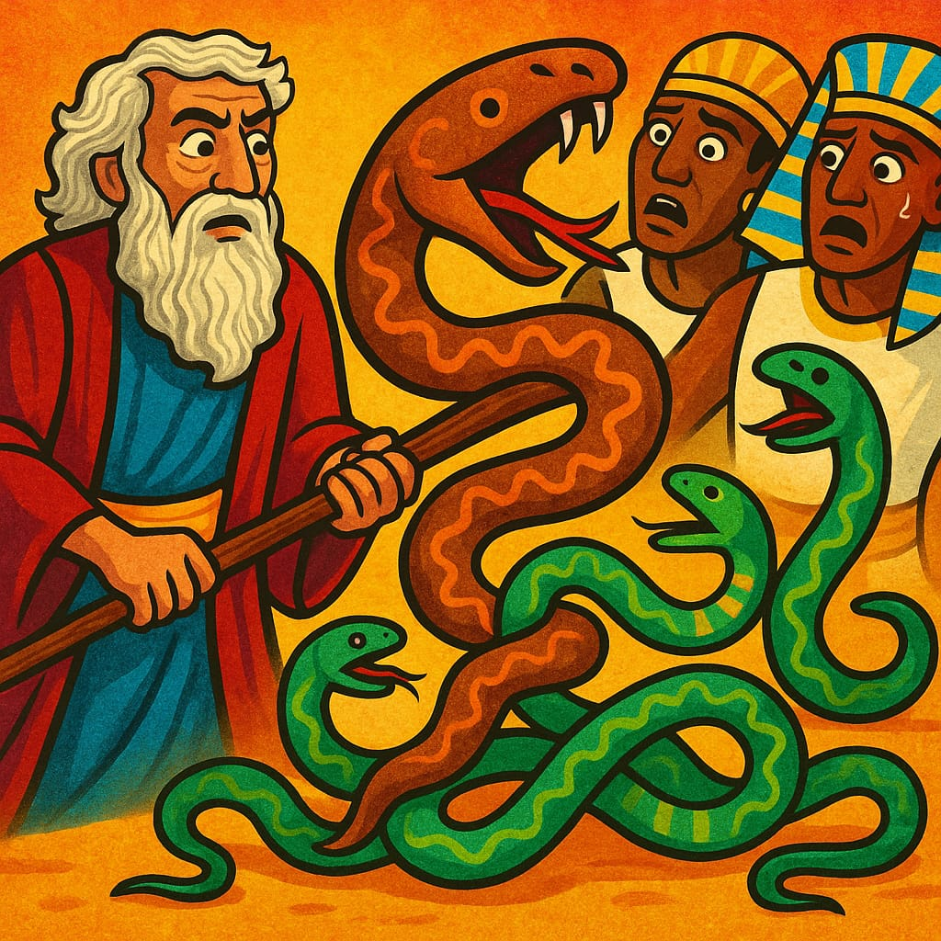
Focus On
THE
MESSAGE
Not The Signs.
Pharaoh Let My People Go

Slide 2
Text : Marks 16:17-18, Rom. 15:17-19, 1 Corinthians 2:4-5, Hebrews 2:4. John 4:48. Exodus 6:11–12
INTRODUCTION:
Both Moses and magicians performed signs—but only one had the true message from God. Signs attract, but the message transforms.

Slide 3
Many have become obsessed with signs, ignoring the real message God is communicating. This is where denomination miss it. The wonders and signs are not the message but an attraction but many have left the message and focus on the signs. Permit me to say that signs do not save but the message saves. …

Slide 4
…What is the message oga pastor, don't only show us the signs, after the display of powers oga pastor, what next? The message is let my people go that they may worship me in truth and spirit. Many pastors in the word has cage their members with signs and wonders. Oga pastor the evident God is with you is not...

Slide 5
… the signs only but the Message. The message comes before the signs. My sermon topic here is focus on the message not the signs. Deuteronomy 13:1-4.
Sermon Note: every sign and wonder either comes from God (Acts 5:12), man (Mathew 24:24) or devil. (Exodus 7:11-12)

Slide 6
I . SIGNS ARE NOT THE MESSAGE
a. Signs Draw Attention, but They Are Not the End Goal John 6:26
b. Signs can be counterfeited; the message cannot . Exodus 7:11.
C . Signs can be misleading if not anchored to truth Matt. 24:24,
2 Thessalonians 2:9-10

Slide 7
Sermon Note: Not all signs are from God. Don't be led by signs—be led by the Word. .

Slide 8
II . THE MESSAGE IS THE TRUE POWER
a . The Message Comes First Exodus 5:1 Before any signs, God gave Moses the message. The signs were meant to support the message, not to replace it.
b. The Message Saves, Not the Signs Romans 1:16. 1 Corinth. 1:21-23.

Slide 9
Sermon note: Many are excited by signs, but signs do not save—the gospel message does.

Slide 10
III. MODERN ERROR: SIGNS WITHOUT SUBSTANCE
a. Many Pastors Focus on Signs Without Preaching the Word
“Oga Pastor, after the power display, what next?” 2 Timothy 4:3-4 Some ministries hold members captive with signs, without giving them the truth that sets free (John 8:32).

Slide 11
b. The Real Evidence God Is With You: The Message john 17:8, Mark 16:20.

Slide 12
IV. WHAT IS THE MESSAGE?
Exodus 9:1
SEMON NOTE: God is not just showing power—He is calling people out of Egypt (sin, bondage) into worship in Spirit and truth.
b. Christ is the Message Heb. 1:1-2. Acts 10:36. Acts 4:12.

Slide 13
CONCLUSION: FOCUS ON THE MESSAGE
Signs are temporary; the Word is eternal (Isaiah 40:8). Let us not be among those who follow signs, but never obey the voice of God.

