Slide 1
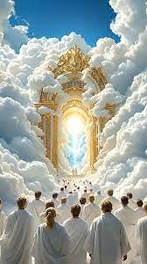
From
here
To
ETERNITY

Slide 2
INTRO:
God will never leave His people in confusion or darkness. He has given them the Spirit of truth to teach them all things and lead them in all truth – John 14 : 26

Slide 3
Point 1: Salvation is a program / agenda of God, and it has been concluded from the foundation of the world. Acts 15 : 18, Rev. 13:8, Rev. 17:8
God has an attribute of declaring the end from the beginning – Isaiah 46:9-10, Psalm 33:11, Dan. 2:28, Isa. 42:9, Acts 3:18
Concerning the program of redemption, He has declared in His word step by step what will happen till redemption is over. Eph. 1:9, Rom. 16:25

Slide 4
Note: Redemption is like a movie, a movie is directed and acted according to its script. The script tells the end of the movie. The word of God is the script of redemption.
Point 2: Our study is from here to eternity.
Where are we? Ans.: Mark 4:29
Where is here? The last stage of the
restoration move of God (perfection of the church)

Slide 5
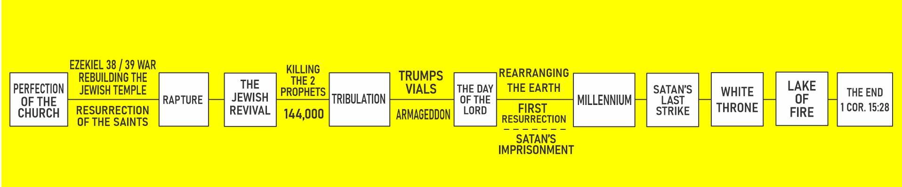

Slide 6
Ezekiel 38/39 War.
Rebuilding The Jewish Temple
Killing
The 2 Prophets
Trumps
Vials
PERFECTION OF THE
CHURCH
RAPTURE
THE
JEWISH
REVIVAL
TRIBULATION
THE DAY
OF THE
LORD
144,000
ARMAGEDDON
Resurrection
Of the Saints

Slide 7
RE ARRANGING
THE EARTH
THE DAY
OF THE
LORD
MILLENNIUM
SATAN’S
LAST
STRIKE
WHITE
THRONE
LAKE
OF
FIRE
THE
END
1 COR. 15:28
FIRST
RESURRECTION
SATAN’S
IMPRISONMENT

Slide 8
THE TIME TABLE
PERFECTION OF THE CHURCH
EZEKIEL 38/39 WAR, REBUILDING THE TEMPLE (REV. 11:
RESURRECTION ( 1 COR. 15 : 51 – 54, 1 THES. 4 : 16)
RAPTURE
THE JEWISH REVIVAL
ZECH. 12 : 10-13, ZECH. 13:1, 7, REV. 11 : 2 - 12
KILLING OF THE PROPHETS (REV. 11 : 7 – 12)
THE 144,000 (REV: 11: 8)
THE KILLING OF THE 2 WITNESSES BEGINS THE TRIBULATION
TRIBULATION
REV. 12 : 13 - 17
TRUMPETS – REV. 8, 9, 11:15
EVERLASTING GOSPEL REV. 14 : 1 - 12
VIALS – REV. 15
ARMAGEDDON – REV. 14:14-20, JOEL 3:9-21, REV. 19:11-19

Slide 9
THE DAY OF THE LORD
2 PETER 3 : 10 - 13
REARRANGING THE EARTH (REV. 21 : 1)
FIRST RESURRECTION (REV. 20:4-6)
SATAN’S IMPRISONMENT (REV. 20:1)
MILLENIUM (KINGDOM)
ISAIAH 65:17-25, ISAIAH 11:1-9, ZECH. 14:9, MICAH 4 : 14
SATAN’S LAST STRIKE
REV. 20 : 7-10
WHITE THRONE
REV. 20 : 11 - 13
LAKE OF FIRE
REV. 20 : 14 - 15
THE END
1 COR. 15 : 28
Prophecy only covers time, eternity is outside time, therefore, prophecy cannot reveal eternity to us
Conclusion:

