Slide 1
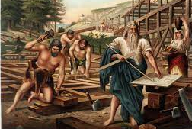
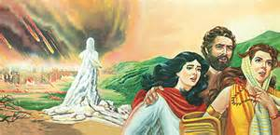
LESSONS
FROM THE DAYS
OF NOAH AND LOT

Slide 2
2 Timothy 3 : 15-17, Rom. 15:4, 1 Cor. 10:11
Old testament stories hold great lessons for us in the new testament
From the stories in the Bible, there are two generations that are specifically a type of the endtime.
In fact they are prophetic endtime generations the generation of Noah and the generation of Lot Luke 17:22-32

Slide 3
These two generations are a prophetic type of how the coming of Christ will be.
There are several lessons to learn from them Gen. 6:1-22, Gen. 7:1-16 – Noah Lot – Gen. 19:1-29

Slide 4
Lesson 1
Few people will be saved
Noah’s day – Eight (8) people saved
Lot’s day – Three (3) people saved
Luke 13:22-27 People won't go through the normal way
2 Peter 2:1-2 False teachers misleading

Slide 5
Lesson 2
The Saints will leave before the judgment comes Gen. 7:1-17, Gen. 19:12-24. We will go in the rapture before any judgment comes
Note: This is what let us know that there are two comings of Christ ahead of us.
John 14:1-3, 2 Thes. 1:7-8, Rev. 1:7, Rev. 19:11-16, 1 Thes. 4:16-18
Firstly, he is coming to rapture, secondly to judge.

Slide 6
Lesson 3
Salvation will only come by following God’s provided way. Gen. 6:13-22, Gen. 7:1
The ark he built was what saved him
Gen. 19:17-22
Note: Lot’s wife a type of believers who didn’t follow God’s provided way – Gen. 19:26
The way for us Col. 1:27, John 3:6, Ezek. 36:24-26

