Slide 1
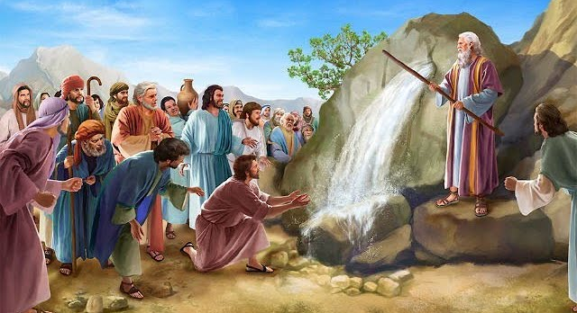
MOSES AND THE ROCK

Slide 2
Introduction :
2 Timothy 3 : 15 – 17, Romans. 15 : 4
Stories in the Bible teach us a lot of things about salvation.
Text:
Exodus 17 : 1 – 7, Numbers 20 : 1 - 13
Our emphasis in this story is the man of God -Moses

Slide 3
Points to Note :
In the first event God told moses to strike the rock, it brought forth water.
In the second case God told him to speak to the rock.
Moses disobeyed but the water came out.
The people drank the water, but judgment was hanging on Moses

Slide 4
Lessons To Learn:
The rock was a type of Christ 1 Cor. 10 : 1 – 12 (vs 4).
Christ cannot be smitten twice Hebrews 10 : 26 – 31, Hebrews 6 : 4 - 6
Disobedience to the will of God may bring momentary blessings but eternal or serious consequences. Matthew 7 : 21 -23 - it cost him the promised land 1 Samuel 15 : 1 - 23

Slide 5
Conclusion :
Obedience is better than sacrifice, do service for God according to his will – 2 Sam. 6 : 1 - 9

