Slide 1
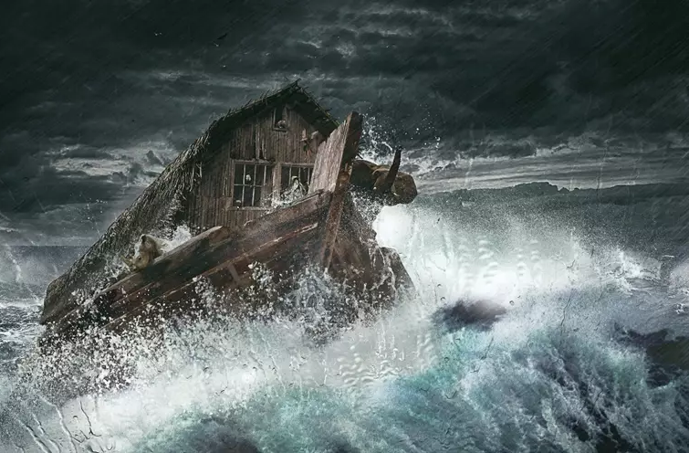
THE DAYS OF NOAH
(Gen. 6, 7)

Slide 2
We shall divide the days of Noah into four (4) parts
THE HUMAN CONDITION
Gen. 6:3 Men became flesh (carnal) (Gal 5: 19 – 21)
Gen. 6:4 Men became mighty Gen. 10:6 – to rival God, to be without the need for God
Gen. 6:5 The wickedness of man was great (violence, war, hostility, evil)

Slide 3
THE CONCLUDED JUDGMENT
Gen. 6:3-7
Destruction in 120 years concluded and
pronounced in God’s mind

Slide 4
THE SALVATION OF NOAH
Gen. 6:8-22, Gen. 7:1
- Noah found grace
Noah informed of the plan of God to
judge the world.
Noah told the way to escape it
- Noah found righteous – Gen 7:1
Righteousness came by obedience
- Psalm 3 vs 8

Slide 5
Only a few (8 souls) were saved from the destruction
Gen. 7:11-13
- Noah preached for a 100 years
2 Peter 2 : 5

Slide 6
THE SECOND HISTORICAL WITNESS
Is the generation of Lot
THE HUMAN CONDITION
Wickedness - Gen. 13, 13 Ezekiel 16, 49, 50
2 Peter 2:6-9,
Jude 1 : 7
Sexual perversion Gen 19: 4 – 8
Became a societal norm

Slide 7
CONCLUDED JUDGMENT / DESTRUCTION
Gen. 19: 12 - 13
THE SALVATION OF LOT
Gen. 19: 15 – 19 – Lot found grace

Slide 8
ONLY FEW WERE SAVED
3 people only
Gen. 18: 17 – 33 – God will not destroy the righteous with the wicked.
Before the world can be destroyed righteousness must be scarce ( 1 Peter 4 : 18)
God must remove the righteous few – Rapture before destruction.
Lot’s wife an example of those who found grace, but didn’t become righteous – she fell of grace. Gen. 19:26

