Slide 1
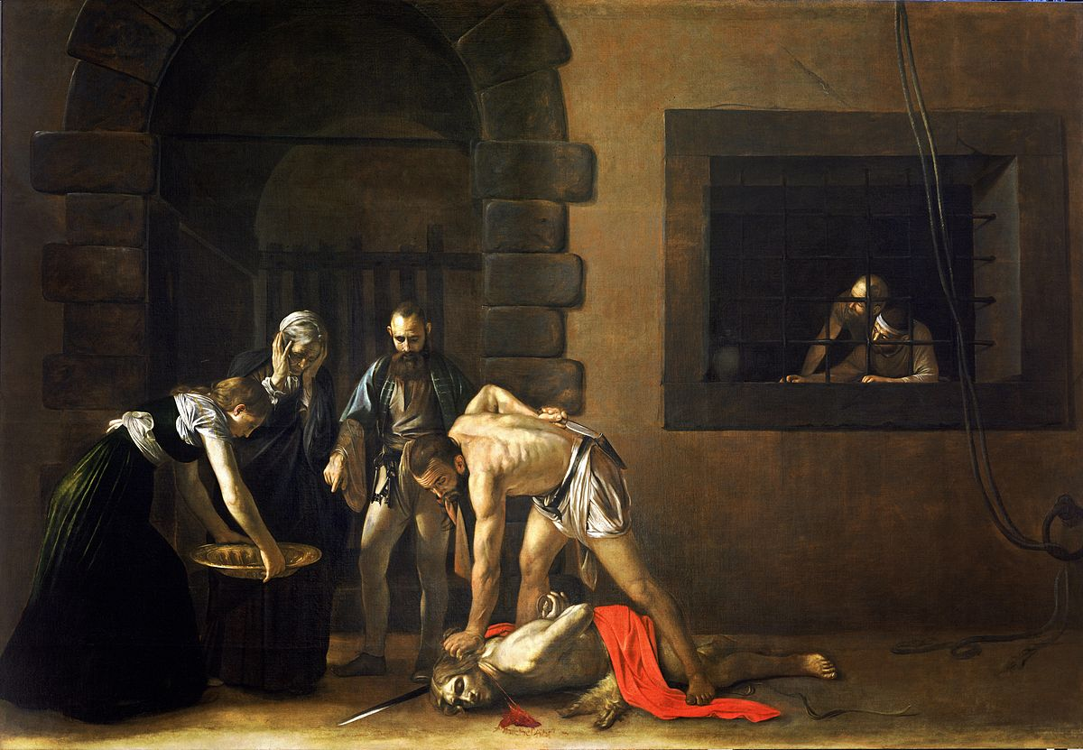
THE
DEATH
OF JOHN
THE
BAPTIST
THE
DEATH
OF JOHN
THE
BAPTIST

Slide 2
TOPIC:
THE DEATH OF JOHN THE BAPTIST
MEMORY VERSE:
ISAIAH 8: 18
ROMANS 8 : 28
TEXT:
MATTHEW 14 : 1 – 2
MARK 6 : 14 - 29

Slide 3
Points to note:
The death of John the Baptist is a testimony – it holds a message for the children of God.
John the Baptist was a special vessel of God: chosen to forerun the first coming of Christ.
Scriptures concerning him:
Mal. 3: 1, Mal. 4 : 5 – 6, Isaiah 40 : 3 – 5,
Luk. 1 : 12-17

Slide 4
If he was a special vessel then his life was divinely directed. Luke 1 : 57 - 80
He fulfilled his ministry / purpose which was to introduce Jesus: John 1 : 29 – 34.
Jesus bare record of him as the greatest among men born of women before the kingdom of heaven started. Matt. 11 : 11

Slide 5
What is the message of his death?
That greatness before God is not greatness before man.
That the true messengers of God are not known or popular in the world.
That preaching the truth is costly.
That a successful life before God is not in how long you live but how well. He died at 30 or 31 years.

Slide 6
That God may allow predicaments in our lives in order to fulfil His purpose.
John 3 : 27 – 30
That a life lived to fulfil God’s purpose is strange and odd to men
CONCLUSION:
Rom. 8 : 28, 2 Tim. 1 : 9
Let us live to fulfil God’s purpose no matter the cost.

