Slide 1
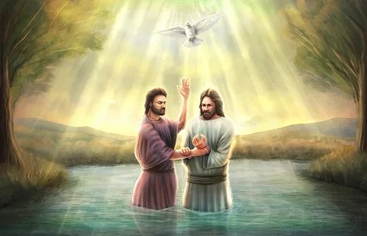
THE LAMB AND THE DOVE

Slide 2
2 timothy 3:15-17
John 1:28-34:
THIS STORY GOES BEYOND THE LORD JESUS ALONE, IT HOLDS A SERIOUS LESSON FOR US ESP. AS WE WAIT FOR THE HOLY GHOST BAPTISM.

Slide 3
TWO CHARACTERS:
THE LAMB OF GOD
THE DOVE
THE DOVE
THE DOVE IS THE HOLY SPIRIT (JOHN 1:32). THE HOLY SPIRIT IS SYMBOLIZED AS A DOVE BECAUSE OF THE DOVE’S NATURE: CLEAN, MEEK, GENTLE, PURE ETC.

Slide 4
TWO CHARACTERS:
THE LAMB OF GOD
THE LAMB OF GOD IS THE CANDIDATE FOR THE HOLY GHOST.
(Examples; ACTS 2:36-38, ACTS 10:1-END, 2 KINGS 2:1-13, ACTS 1:1-8).
THE LAMB OF GOD IS LED BY HIS WORD
(ACTS 5:32).

Slide 5
TWO CHARACTERS:
N/B
THE DOVE WILL NOT COME ON ANOTHER ANIMAL, EXCEPT THE LAMB.
REPENT AND BE A LAMB TODAY – ONLY THE LAMBS WILL HAVE THE DOVE COME ON THEM.

