Slide 1
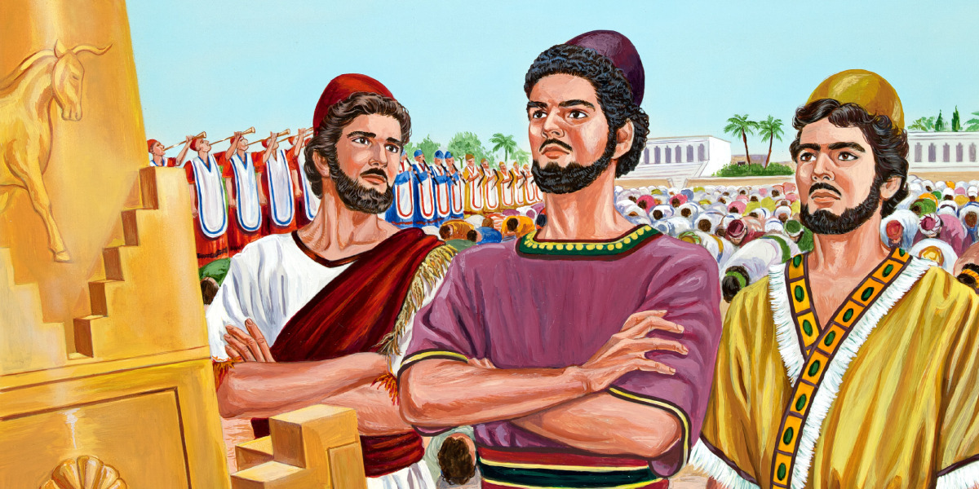
THE LITTLE REMNANT

Slide 2
THE LITTLE REMNANT
TEXT: Isaiah 1:9
“Except the LORD of hosts had left unto us a very small remnant, we should have been as Sodom, and we should have been like unto Gomorrah.”

Slide 3
PART ONE: THE LITTLE REMNANT AND THE BRIDE OF CHRIST
The Bride of Jesus Christ can be identified as the little remnant of this age.
In every generation, the true people of God have always been in the minority, even though many claim to follow God.
“For many are called, but few are chosen.” — Matthew 22:14
The Lord Jesus described His disciples as a little flock. Luke 12:32

Slide 4
God has standards by which He separates the multitudes from the true worshipers.
John 4:23–24
He is looking for true worshipers. The majority always fall short of His standards; only the little remnant remains faithful to God.
God’s standard is His Word.

Slide 5
PART TWO: BIBLICAL EXAMPLES OF THE LITTLE REMNANT
1. The Days of Elijah
Scriptures: Romans 11:1–51, Kings 19:8–18
Despite the great showdown on Mount Carmel and the mighty miracles God performed through Elijah, only seven thousand people were left in Israel who did not bow to Baal.
The people publicly acknowledged Yahweh as God: “The LORD, He is God.” — 1 Kings 18:39
Yet they did not worship Him truly.

Slide 6
This is a picture of what is happening in Christianity today—acknowledging Jesus with the lips while bowing to the gods of sin, pleasure, entertainment, mammon, and self.
Israel was outwardly religious. They professed Yahweh outwardly but did not worship Him in truth.
Even the prophets were compromised:
1 Kings 22:6 — prophets who bowed to Baal.

Slide 7
The life of Israel had become corrupt and unjust:
1 Kings 21:8–14
Whenever we disobey God’s Word, our worship becomes vain.
Despite Israel’s population and the visible manifestation of God’s power, only seven thousand truly stood with God.
Religion is not spirituality.

Slide 8
2. Daniel and His Friends in Babylon
Scripture: Daniel 1:1–17
Daniel and his three friends are another clear example of the little remnant. Among many Jews in Babylon and in the king’s palace, only four stood without compromise.
They separated themselves by obedience, consecration, and faithfulness to God, even in a foreign land.

Slide 9
3. The Season of Christ’s Birth
At the time of Christ’s birth, the land was filled with religious activity and divided into various sects—Pharisees, Sadducees, Herodians, and others.
They were outwardly religious, yet they did not worship God in truth.
The Lord Jesus exposed this in Mark 7.
Yet God still preserved a little remnant:
Simeon and Anna — Luke 2:25–38
The Shepherds — Luke 2:8–20
Zechariah and Elisabeth, Mary and Joseph — Luke 1:67–78.
They were few, but they were faithful.

Slide 10
4. The 120 Disciples in the Upper Room
The disciples in the upper room were the true disciples of Jesus.
They were the ones who waited for the promise of the Father and received the Holy Ghost.
Although multitudes followed Jesus during His ministry, He ended with only 120.
Matthew 5:1–2
What separates the multitudes from true disciples is the Word.
Obedience to the Word of God is the test of true discipleship.

Slide 11
PART THREE: WHO ARE THE LITTLE REMNANT?
The little remnant are:
Those who remain faithful to God to the end, refusing pressure, compromise, and conformity.
Those who follow the Word for their day and abide in present truth.
Those who are not hearers of the Word only, but doers also.
These are the little remnant. They may be few, but they are precious in the sight of God.
Be part of the little remnant.

Slide 12
Shalom

