Slide 1
THE POWER
OF
CONSECRATION
Text: Romans 12:1-2, 2 Timothy 2:19-21, Galatians 2:20, Joshua 3:5, Romans 6:13, Phil. 1:21.

Slide 2
Introduction:
Consecration is the sacred act of surrendering our whole being—body, soul, and spirit—completely to God. It's not just about avoiding sin; it's about offering ourselves fully for His purpose, letting Him use our lives as vessels of His glory. In a world full of distractions and self-centered living, consecration calls us to lay it all down and say, "Lord, I am Yours—completely, unreservedly, and forever." Isaiah 6:8

Slide 3
Everything in the world that looks positive or negative has gone through one consecration or the other.
1 Samuel 17: 33-36. Acts 23:12-14. Isaiah 66: 17

Slide 4
DEFINITION OF CONSECRATION
C – Commitment
Consecration begins with a total decision to follow God wholeheartedly. Joshua 24:1-2, 15-17, Daniel 1:8
O – Obedience
A consecrated life is a life of obedience to God's voice above all else.
1 Samuel 15:22, Genesis 22:2

Slide 5
N – Newness of Life
Consecration brings a change — a break from the old life into a new walk with God. John 3:14. 2,
Romans 6:4, 2 Corinthians 5:17.
S – Sanctification
Sermon Note: To be consecrated means to be set apart and purified for God's use.
1 Thessalonians 4:3, Exodus 19:10-11.

Slide 6
E – Endurance
Consecration calls for steadfastness through trials and tests. Genesis 39:8-20, Genesis 41:37-44.
Job 1:21-22.
C – Christ-Centered Living
Our lives must revolve around Christ; He is the reason and purpose for our consecration.
Galatians 2:20
Luke 10:41-42

Slide 7
R – Righteousness
A consecrated person pursues God’s righteousness, not self-righteousness. Matthew 6:33
A – Altar of Sacrifice
Consecration means laying your will, desires, and plans on God’s altar.
Romans 12:1
1 Kings 18:33-38.

Slide 8
T – Transformation
True consecration transforms the mind, heart, and life.
Romans 12:2
Acts 9:17-18
I – Intimacy with God
Consecration brings us into deeper communion and closeness with God.
James 4:8.

Slide 9
O – Offering of Worship
A consecrated life is a living act of worship, not just words.
John 12:3
N – No Turning Back
Consecration is a lifelong journey - no retreat, no surrender.
Luke 9:62, Genesis 19:26, Hebrews 11:24-26

Slide 10
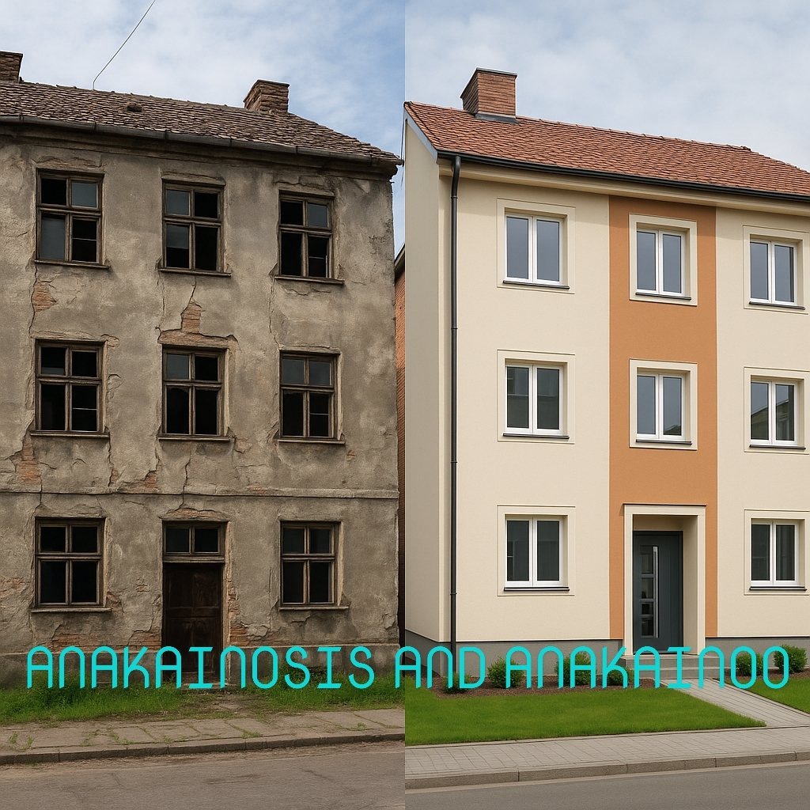
ANAKAINOSIS AND ANAKAINOOOO

Slide 11
SHALOM!

