Slide 1
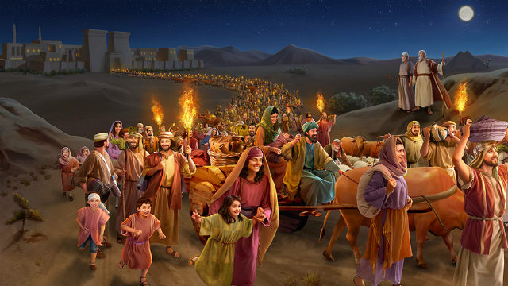
THE PRESENT EXODUS
THE ISRAELITES LEAVING EGYPT

Slide 2
THE PRESENT EXODUS
Dictionary definition:
It means an exit, a departure or a going out
Spiritual definition:
God bringing his people out of bondage into freedom

Slide 3
The exodus we have seen so far:
1. Exodus from Egypt to the promised land
2. Exodus from Babylon to Judah
3. Exodus from Law to Grace
4. The present Exodus

