Slide 1
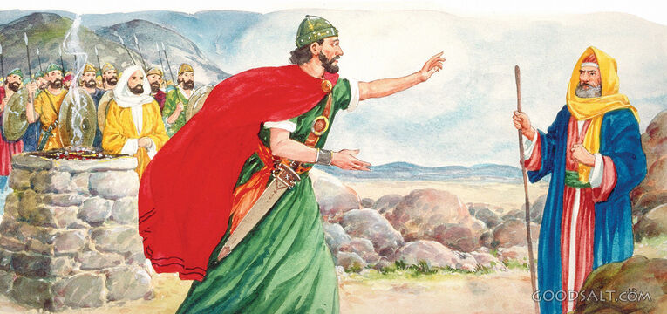
THE REJECTED KING
Looking at the story of a man who was made king, then rejected by God.
2 Tim. 3: 15 – 17, Rom. 15 : 4

Slide 2
AIMS:
To know the real reason why God removed him.
To know how it applies to us.
To study in contrast another king who despite his great sin God did not reject him.
To see other examples of people who walked in the path of the rejected king.
References: 1 Samuel 13, 1 Samuel 15, 2 Samuel 6,
2 Samuel 11, 1 Kings 1, 1 Kings 2.

