Slide 1
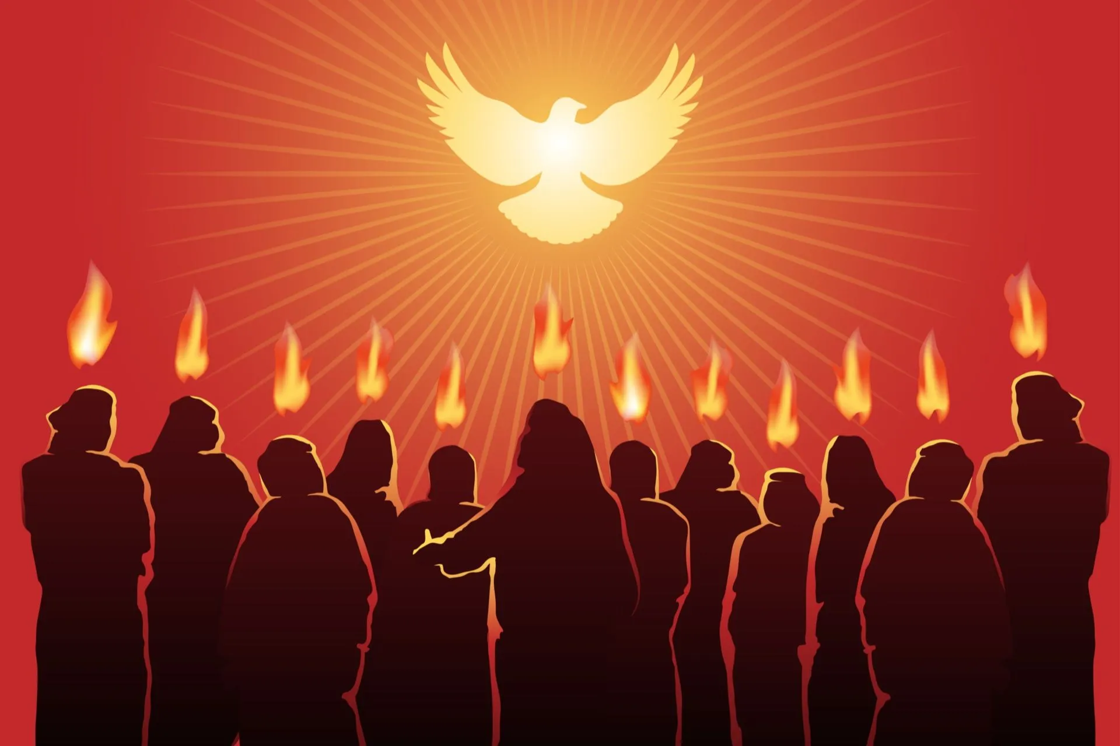
THE UNITY OF THE FAITH
(That they may be one)

Slide 2
Ephesians 4 : 13, Psalm 133, John 17 : 21
The desire of the Lord Jesus is the unity of His followers
But looking at Christendom today, you will agree with me that we are not one, we are not united.
The followers of Jesus are divided now more than any other time in history; this divisions keep increasing on a daily basis.
The lack of unity is what has provided the numerous denominations in Christendom.

Slide 3
POINT 2
There are carnal approaches that have been taken to unite the church, but it all ends in failure, not bringing about any true unity. For example:
W.C.C, C.A.N, P.F.N, G.C.F (Global Christian Forum),
W.E.A (World Evangelical Alliance),
A.A.C.C (All Africa Conference of Churches),
N.C.C (National Council of Churches),
Focolare movement, Lausqnne movement, e.t.c.
All these bodies and many more have not brought any unity.

Slide 4
POINT 3
The Tower of Babel as a case study Gen. 11 : 1 – 9
How did God scatter them? (Gen. 11 : 7 – 9) by confounding their language

Slide 5
POINT 4
If there will be unity, we must all speak one language
The language that Christ has given us is John 17:13-20 – The Apostolic Word
The prayer of Jesus is not unanswered (John 17:21) it is answered among those that speak His language (John 17:20)
True unity is experienced among the followers of the Apostolic faith. Ephe. 4 : 4 - 6

Slide 6
POINT 5 (tracing the source of the division)
Tares planted by the enemy (Matt. 13 : 24-30)
The infiltration at Nicea (AD 325) Matt. 13:31-32 all manner of people coming into the faith
The Dominating woman – (Roman Catholic) Matthew 13 : 33 (AD 500 – AD 1500)
Other scriptures explaining this Acts 20:28-30, 2 John 1 : 4 – 11, 3 John 1 : 9 – 10, Jude 1 : 3 – 4
The only way to be united in the faith is 1 John 2 : 24 – Back to the apostolic faith

