Slide 1
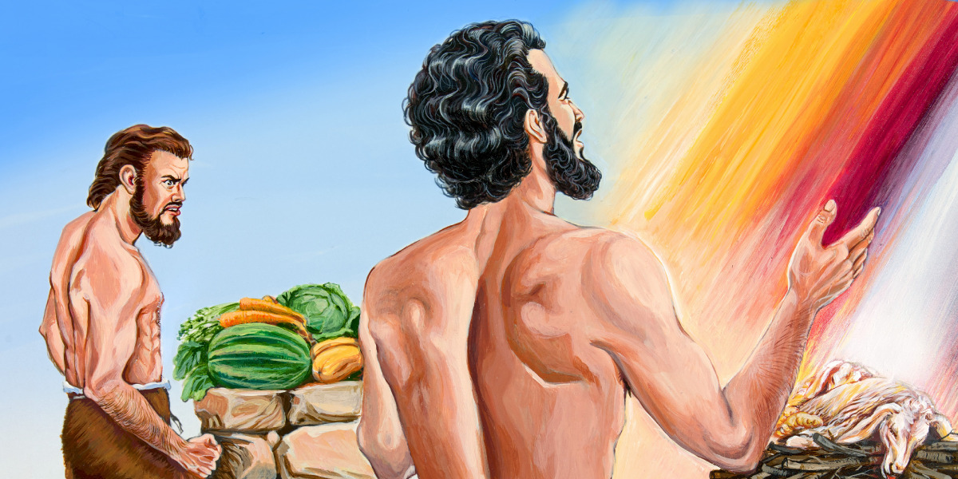
THE WAY OF CAIN

Slide 2
Intro: Rom. 15 : 4, 1 Cor. 10 : 11, 2 Tim. 3 : 15 – 17. Stories in scriptures hold great spiritual lessons for us.
Point 1: What is the way of Cain?
Jude 1 : 11 – Is where we find the phrase “The way of Cain”
Way refers to his pathway of life, his characteristics, his lifestyle, his behaviour, e.t.c.
Prov. 4 : 18 – 19, 26 – His spiritual character.

Slide 3
Point 2: Why should we understand the way of Cain?
It is necessary we understand this because just as two manner of people came from Eve, i.e Cain and Abel. So also, are there two categories of people in the Church of Jesus.
Matthew 13:24 – 30 – The Church of Jesus is a mixed multitude.
Studying the character of Cain will make us understand the character of tares.
…continued

Slide 4
2 Cor. 13 : 5 – Examine yourself.
Studying his way will make us know it and avoid it, so that we don't end up outside God's presence like him Genesis 4:16

Slide 5
Point 3: Understanding his way
He worshipped God in his self-appointed way, not according to God’s provided way.
Cain was religious, Cain believed in God
Amos 3 : 3 – worshiping God or believing in God is not enough, God must be worshiped in the way He has provided, God has a standard.
Matthew 15 : 9
…continued

Slide 6
Cain was angry with God’s chosen way of worship. Gen. 4 : 5 – Angry with the truth after God confirmed it to him.
Cain didn’t repent even after God spoke to him Gen. 4 : 6 – 7
Cain persecuted the true worshiper (Abel) Gen. 4 : 8 – Elect cannot persecute elect. Only the tares will choke the wheat
Cain lied to God and covered his sin Gen. 6 : 9
…continued

Slide 7
No repentance or remorse when his sin was exposed Gen. 4 : 10 – 13
Conclusion: Cain was not killed, but cursed to be a fugitive and vagabond on the earth. God placed a mark on him for his protection.
And he ended outside the presence of the Lord Gen. 4 : 16

