Slide 1
THE WORD TEST
(Another Evidence of Holy Ghost)
Text: John 1:1-14, 2 Timothy 3:16. 2 Peter 1:20-21.

Slide 2
PONTS TO CONSIDER
1. The meaning of the word. In the new testament, Jesus Christ Himself is called the "word" ( Greek : Logos) John 1:1. The concept of Logos in john 1:1-14 is one of the most profound theological ideas in the Bible.

Slide 3
PONTS TO CONSIDER
… It connects Jesus to God's divine wisdom, reason and creative power. Let us explore this further (john 1:1-14) this passage establishes several key truths about Jesus

Slide 4
a. Pre-existence.... Jesus (the logos ) existed before creation . John 1:1-3, colo1: 15-19, Hebrews 1:2-3, john 17:5

Slide 5
b. Distinct yet one with God - the Logos was with God and was God. John 1:1-3, colo1:15-19

Slide 6
c. Creator - john 1:3 states that all things were made through Him.

Slide 7
d. Incarnation - john 1:14, declares " the word became flesh and dwelt among us. This means God took on human form in Jesus Christ. 1 Timothy 3:16,

Slide 8
Note this earthly illustration:
parents ➡words ➡child ➡formation ➡ output.
Deuteronomy 6:6-7

Slide 9
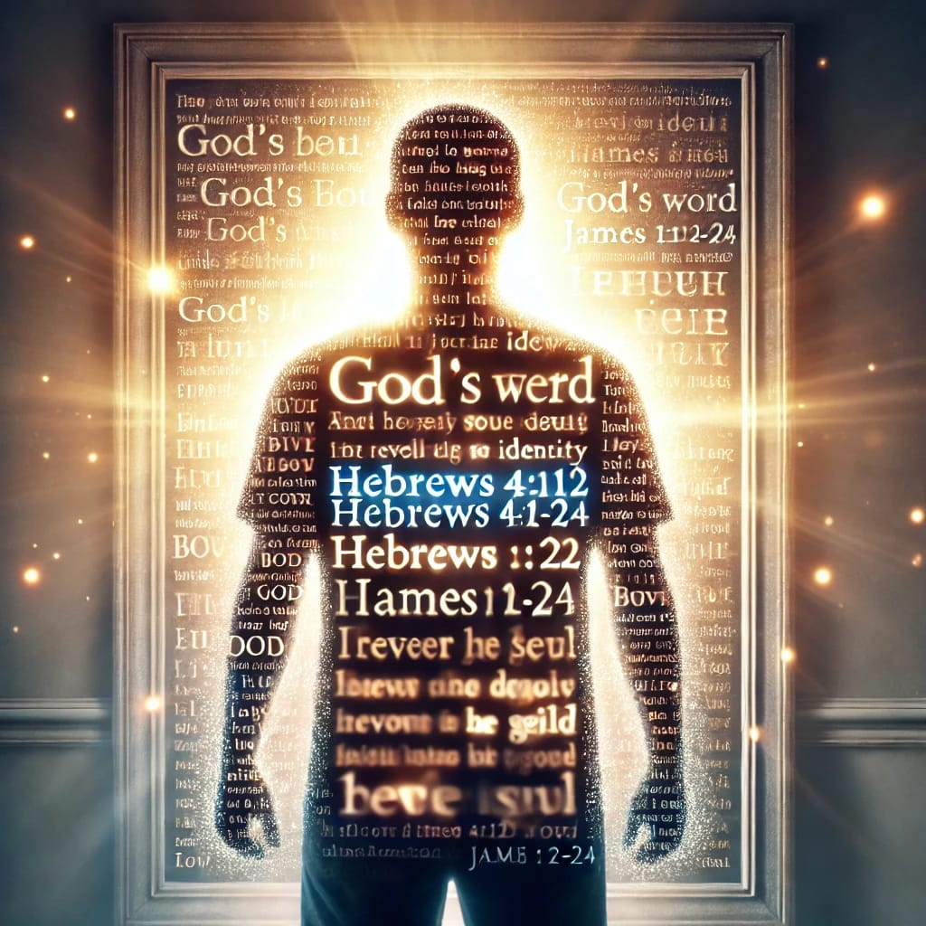

Slide 10
PONTS TO CONSIDER
2. The meaning of "test" 2 Corinthians 13:5, Proverbs 17: 3. This word test has different definitions depending the perspective you are viewing it. But for the sake of our teaching, the word test means the ability to accept, to appreciate, to acknowledge,…

Slide 11
PONTS TO CONSIDER
…. to receive, to agree, to take in, to endorse etc the word of God when being taught, preached or received. Therefore, the word test simply means measuring beliefs, actions or teachings against Scripture. 2 Timothy 3:16-17, Acts 17:11.

Slide 12
3. The prototype of word test
a . The Water baptism. Matthew 28:19, acts 2:38, acts 8:16.
b. The Apostolic office. Eph 4: 11-12, acts 1:21-22, 1 Cor. 9:1, Eph 2:20, Rev 21:14, Jude 1:3,

Slide 13
C. The Women pastors. 1 Tim 2: 11-14, 1 Corinthians 14:34-38, Eph 4:11-16, Gen 3:28.
D. The doctrine of Trinity John 10:30, john 14:9 - 10, John 1:14, Col. 1:16 – 17.

Slide 14
E. The worship of dead saints. Psalm 115:4-5, Exodus 20: 3-5, Isaiah 8:19, Matthew 4:10, Hebrews 9:15, John 14: 6

Slide 15
SERMON IMPORTANT NOTES
The word test proves who you are. James 1:18.

Slide 16
SERMON IMPORTANT NOTES
2. A believer overcomes The word test if the seed (word) of God is in him" John 1:13. 1 Peter 1: 21.

Slide 17
SERMON IMPORTANT NOTES
3. The only difference between a believer and unbeliever is the word. Daniel 1: 8, Matthew 10:8

Slide 18
SERMON IMPORTANT NOTES
4. WE PASSED THE WORD TEST WHEN WE ACCEPT THE TOTALITY OF THE WORD OF GOD.

Slide 19
SERMON IMPORTANT NOTES
4. Matthew 16:13-18, Matthew 13:16-17, John 6:44

Slide 20
SERMON IMPORTANT NOTES
5. The best mirror is the Bible .
"James 1:22-25, Hebrews 4:12, 2 Corinthians 3:18

Slide 21
SERMON IMPORTANT NOTES
6. We are the word made flesh today.
2 Corinthians 3:2-3, Gal 2:20, 2 Corinthians 5:20.*

Slide 22
REASONS WHY PEOPLE FAILED WORD TEST
Lack of readiness of mind acts 17:11
Lack of searching the scriptures daily. 2 Tim. 2:15, John 1: 6- 8

Slide 23
REASONS WHY PEOPLE FAILED WORD TEST
c. The believe of worship of dogmas and creeds.
d. The fear of what people will say.

Slide 24
REASONS WHY PEOPLE FAILED WORD TEST
e. Denominationalism system
f. Pride

Slide 26
The End

