Slide 1
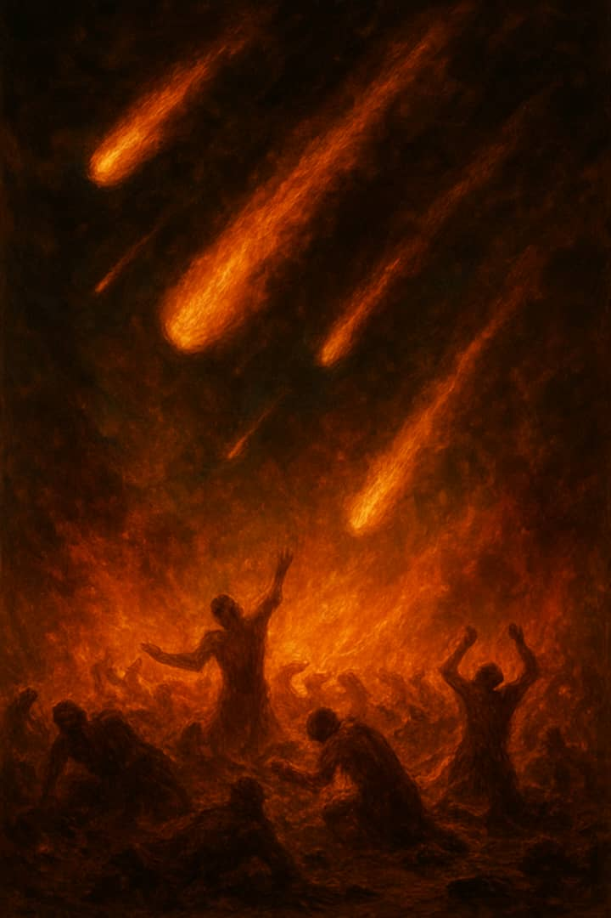
THE WRATH TO
COME
1 Thes. 1:10

Slide 2
Intro:
1 Thes. 1 : 10
Wrath means punishment, retribution or
Vengeance resulting from anger.
Many people are not properly grounded on the subject of the wrath hanging over man

Slide 3
Point 1
The wrath to come is not for everybody – those in Christ are not to be part of it.
The only way to escape the wrath is through our Lord Jesus Christ.
Children of God face His wrath here
The wrath to come is divided into 3.

Slide 4
Point 2
(1) Hell. The 1st Wrath
Heb. 9:27, Eccl. 12 : 7
When one dies without Christ, he goes to hell immediately.
Hell is a prison
Luke 16 : 19 – 31
Hell is a place of torments where the condemned are kept till the final judgment.

Slide 5
Hell is not the lake of fire
Only the condemned will go there, no saint will go to hell
Hell is for the spirit not the body.

Slide 6
The day of the Lord
Point 3
The 2nd Wrath
Another wrath is the day of the Lord.
A moment of intense destruction coming upon the earth and the people living in it.
2 Peter 3 : 4 - 13
Zeph 1 : 14 - 15, Isaiah 13 : 9 - 13
1 Thes. 5 : 2 - 3, Mal 4 : 1 - 2
Haggai 2 : 6 - 7

Slide 7
This will affect only the physical not the spirit or soul of men.
Only those who are alive at this particular time will experience it.
Rev. 6 : 12 - 17

Slide 8
The Lake of Fire
Point 4
The 3rd Wrath
The lake of fire is the final wrath of God upon man.
Many confuse the lake of fire with hell, they are different.
Rev. 20 : 11 - 15
It is only for the condemned.
It is the second death.

Slide 9
It is for complete destruction/annihilation.
Matt. 25 : 41, Rev. 21 : 8
The wrath of God is completely exercised in the lake of fire.

Slide 10
Scriptures that point
Point 5
Severities of Judgment
Rev. 21 : 12 - 13.
Luke 21 : 47 - 48.
Matthew 11 : 21 – 24
Mark 12 : 40.
Rom 2. 5 – 6
Matt. 10 : 15.

Slide 11
If there are degrees of rewards, there are degrees of judgment.
The only way to escape is through Christ.
Noah escaped the wrath of his day.
Lot escaped.
The old testament saints did.
The Bride will escape.

Slide 12
Shalom!

