Slide 1
TYPES AND SHADOWS OF THE
HOLYGHOST BAPTISM
2 Tim. 3: 15 – 17, Rom. 15 : 4, 1 Cor. 10: 13

Slide 2
Salvation is achieved the moment one receives the Holy ghost baptism
1 Cor. 12:13 – The Baptism of the Holy ghost is what brings us into the Body of Christ. You are not yet in Christ until you receive the baptism of the Holy ghost.
Our aim in this study is to bring out certain types and shadows that reflects what the baptism of the Holy Ghost truly is.

Slide 3
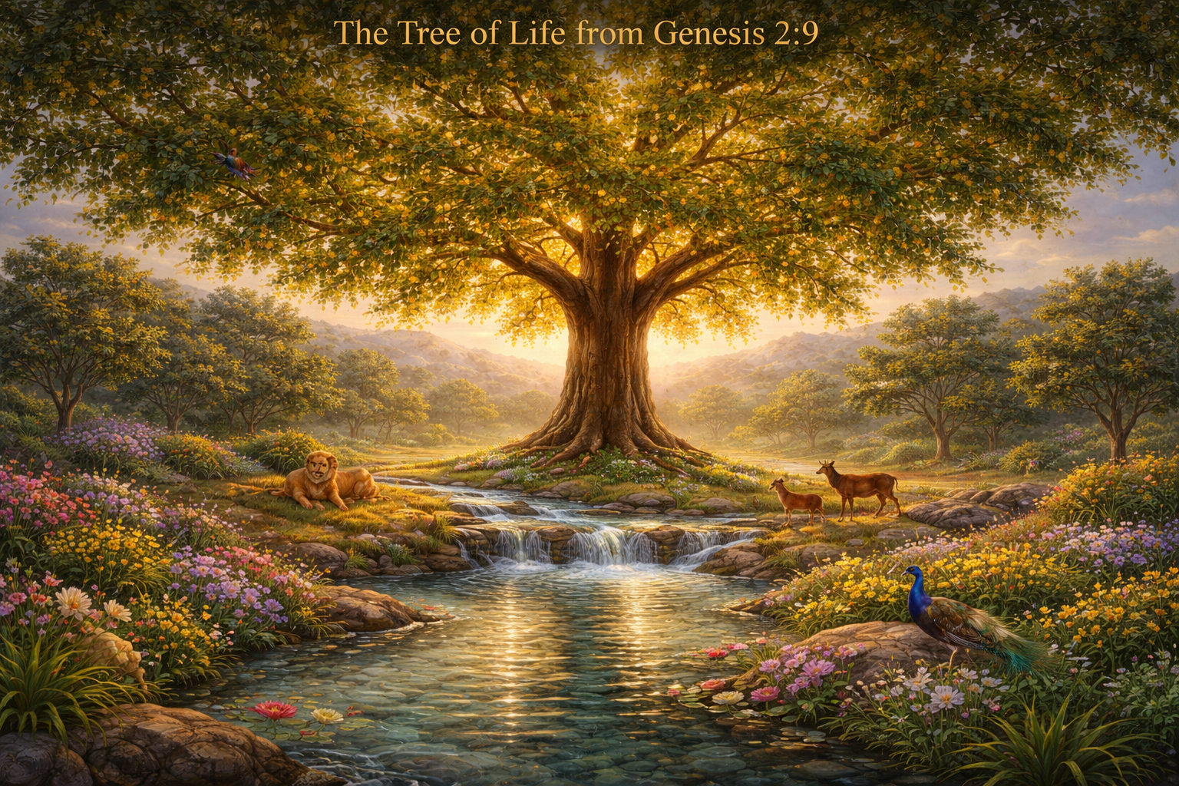
TYPES AND SHADOWS
The Tree of life
Gen. 2:9, Rev. 2:7
Receiving or eating of the tree of life is receiving the baptism of the Holy Ghost

Slide 4
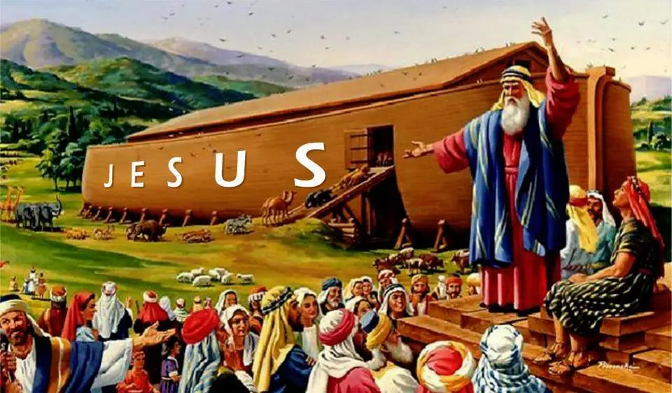
The Ark of Salvation
Gen. 6:5-8, 14-22, Gen. 7
we enter into Christ our Ark through the baptism of the Holy ghost

Slide 5
The Seal of Circumcision
Gen. 17:1-14, Col. 2:11, Rom. 2:28-29
Circumcision was the token (sign) of the covenant between God and Abraham, that Abraham and his descendants belong to God. So also, is the baptism of the Holy Ghost.

Slide 6

The Change of Identity
Gen. 32 :22 - 29
The experience of Jacob is what happens to anyone who receive the Holy ghost baptism. Acts 9

Slide 7
The Inheritance And Blessing of Isaac.
Gen. 25 : 1 – 6, 1 Cor. 2 : 6 - 14
When we receive the baptism of the Holy ghost, we have received the inheritance of Isaac.

Slide 8
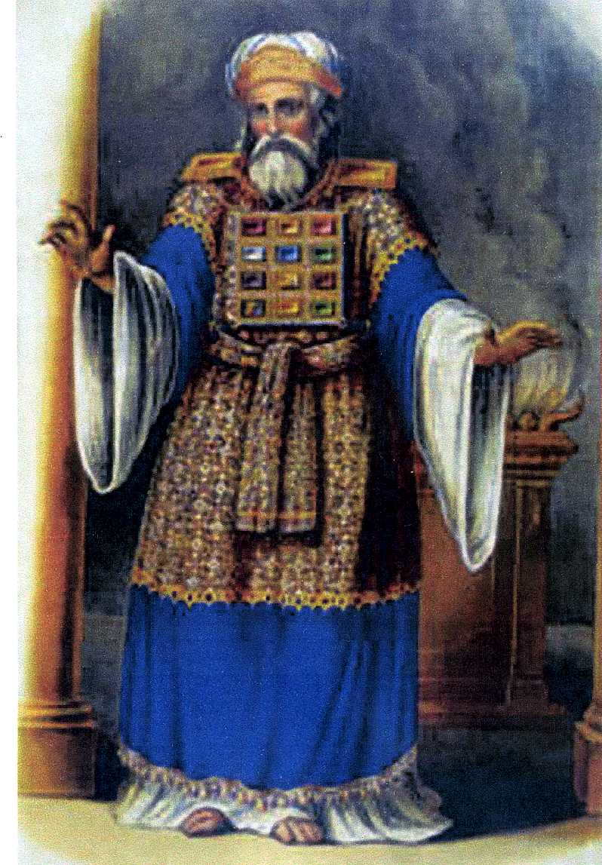
The Priestly Garment and Consecration
Exodus 28 : 1 - 4
Without this garment the priest
can’t be consecrated unto God –
Zech 3: 1 – 5, 1 Peter 2: 9, Rev. 1: 5
We receive our garments to be
consecrated unto the priesthood
when we receive the Holy ghost
baptism

Slide 9
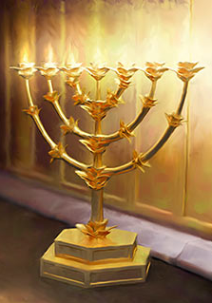
The Oil for the Lamp
Exodus 27 : 20 – 21
  The Lamp is God’s word –
  Psalm 119 : 11.
  Without oil the lamp will not give
  light.
  Matthew 25 : 1 – 13
  Without the Holyghost you won’t
  know the truth or have revelation.
  John 16 : 13, 1 John 2 : 25 - 27

Slide 10
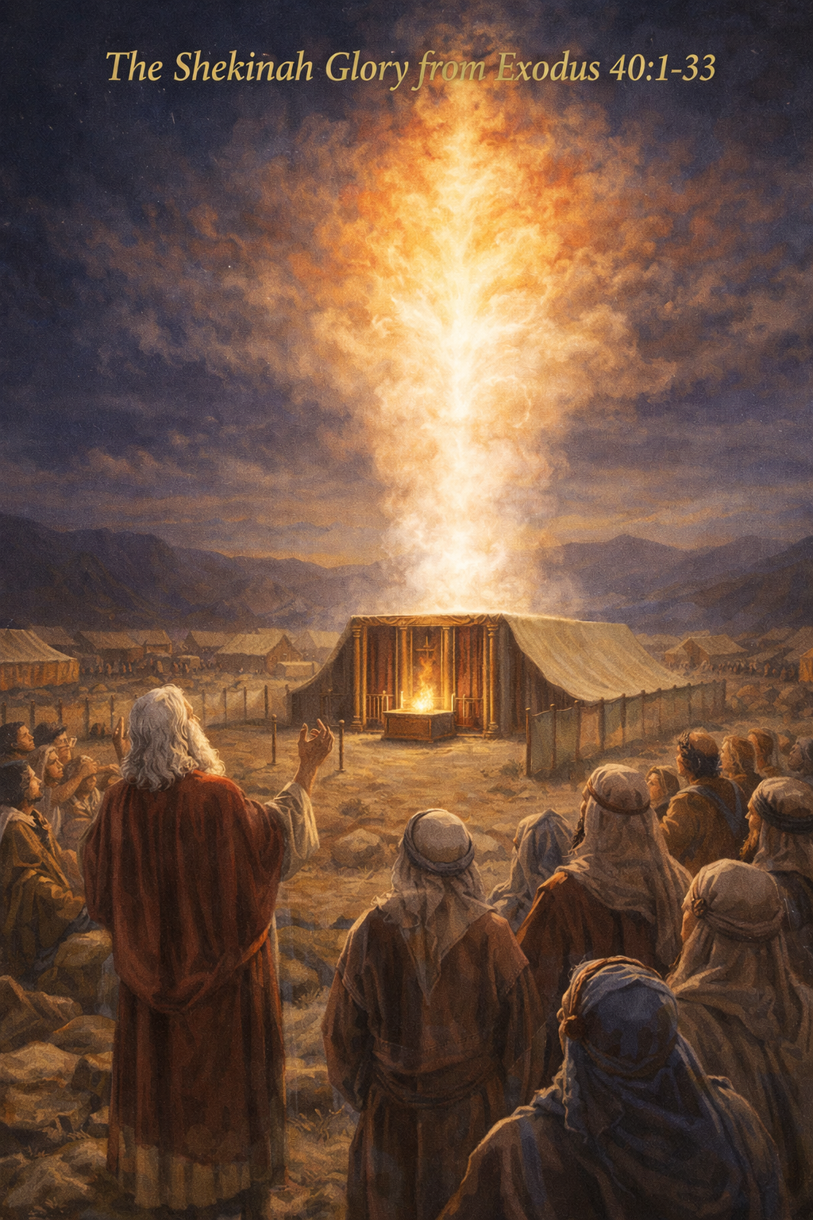
The Shekinah Glory
Exodus 40 : 1 – 33, 33 - 38
  After setting up the tabernacle, the glory descended
  So also when the temple is arranged the glory descends

Slide 11
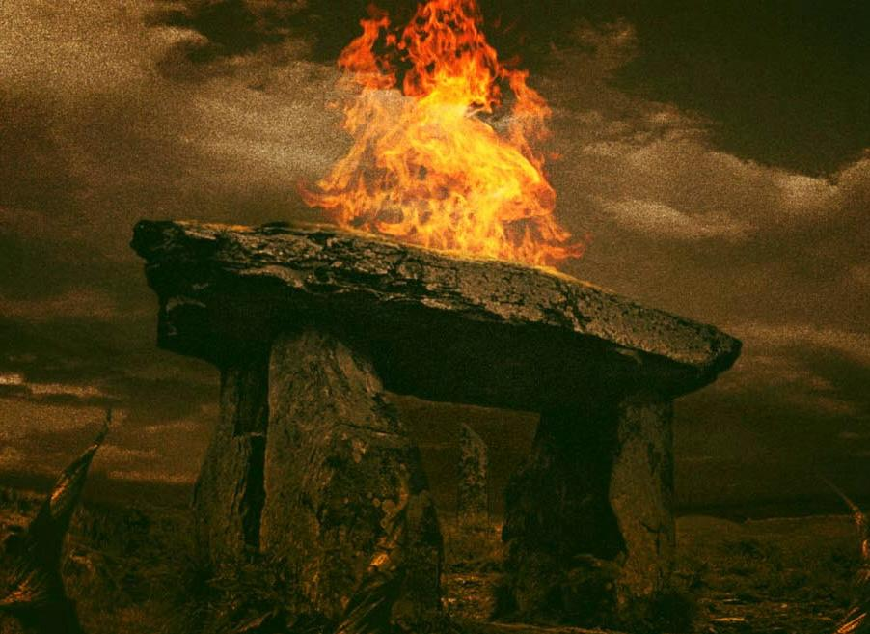
The Fire on The Altar
Leviticus 6: 12-13, Lev. 9:23-24
The ever-burning fire in the life of a believer

Slide 12
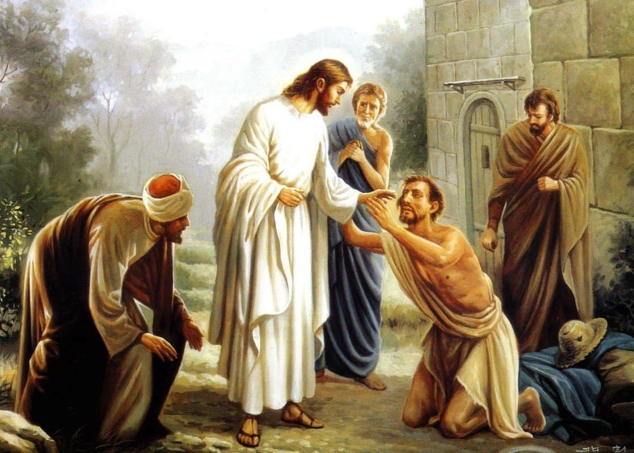
The Healing of Leprosy
Leviticus 13, Leviticus 14
Leprosy is sin, our nature is changed through the Holy Ghost baptism

Slide 13
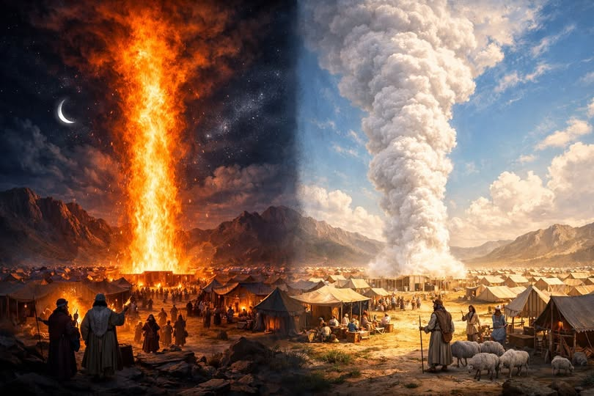
The Pillar of the Cloud and Fire
Numbers 9 : 15 - 23

Slide 14
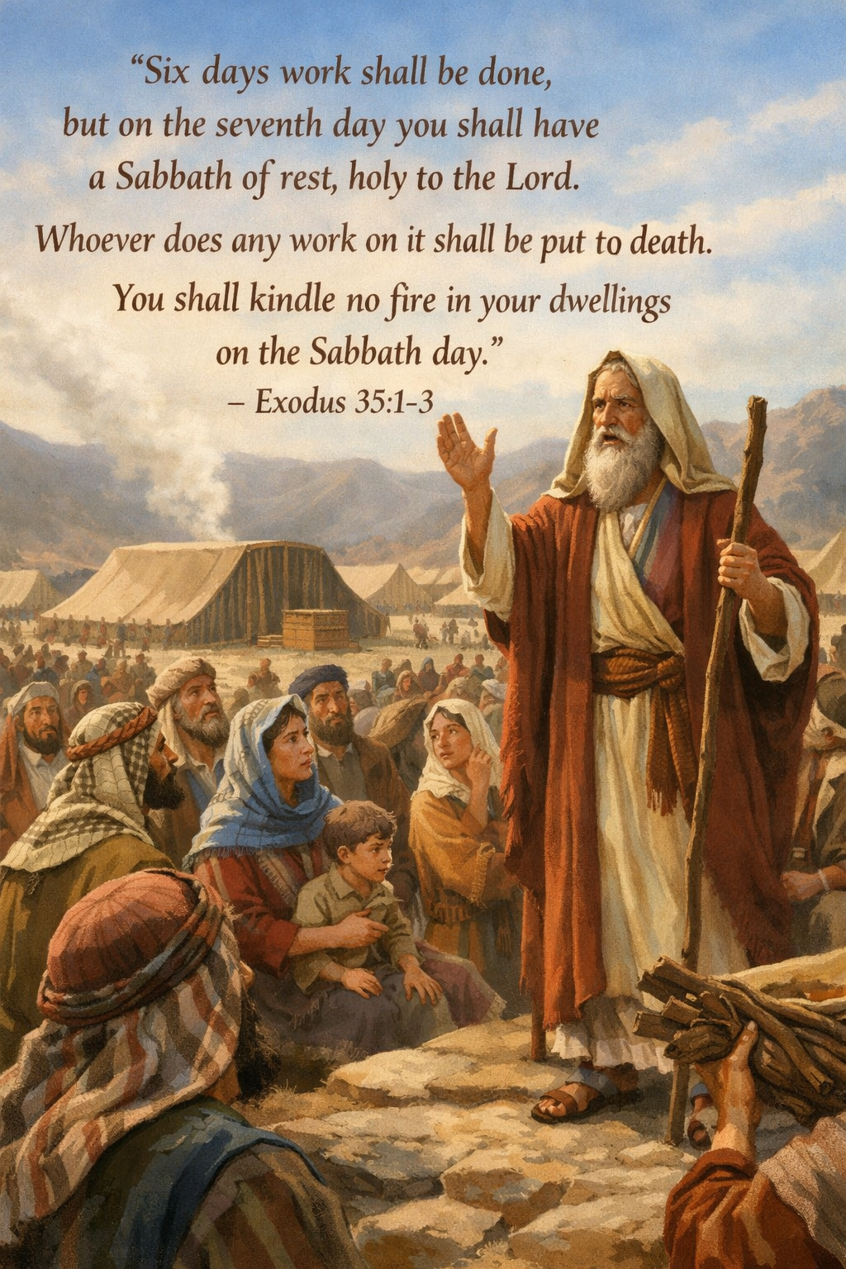
The Rest for the People of God
Exodus 35 : 1 – 3
Leviticus 23 : 3
Hebrews 4 : 1 – 11
The baptism is the rest for God’s people

Slide 15
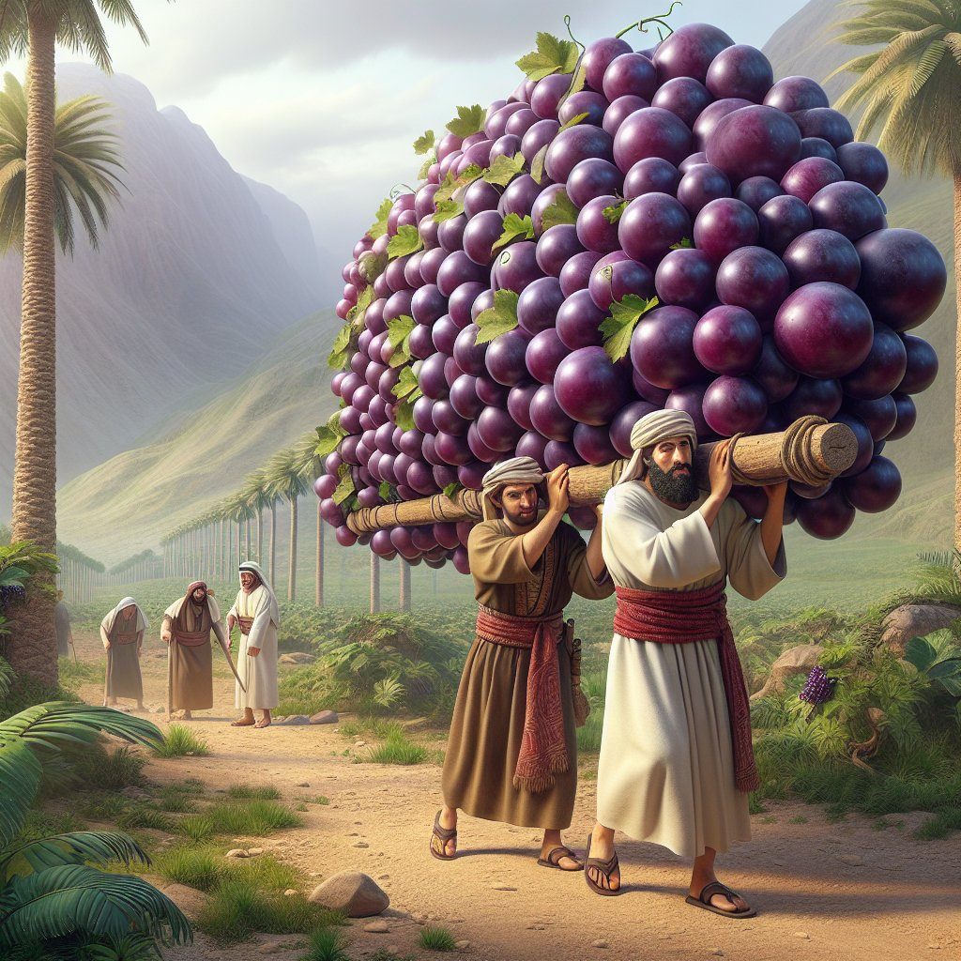
Fruit of the Promise Land
Numbers 13 : 1 – 24
The baptism of the
Holy ghost is the earnest of
our inheritance
Ephesians 1 : 13 - 14

Slide 16
conclusion
There are more types and shadows of the Holy ghost baptism in other books of the bible, but these are given to let us have a picture of what the Holy ghost baptism is.
Our salvation is culminated in the baptism of the Holy ghost. Get it by all means

