Slide 1
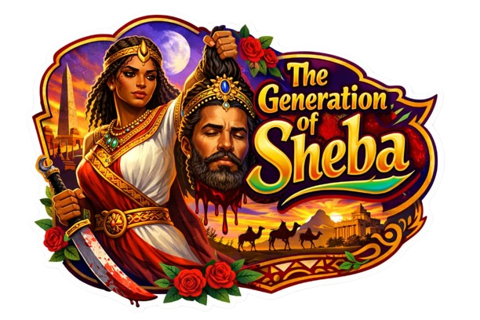
the generation
of
SHEBA

Slide 3
INTRODUCTION:
The Rise of Sheba’s Generation
Text: 2 Sam 20:1-3; 1 Jn. 2:19; Luke 19:11-14
Beloved, we are living in a generation that looks godly, sounds spiritual, and even sings about the King — yet their hearts are far from Him.

Slide 4
A generation that shouts “Jesus is Lord” with their lips, but their loyalty belongs elsewhere or their church.
A generation that believes in His salvation, but refuses His Lordship. This, my brethren, is Sheba’s Generation.

Slide 5
In 2 Samuel 20:1, Sheba rose not because he loved the truth, but because he wanted to turn the hearts of men away from their king.
Just like Sheba, this generation blows the trumpet of rebellion. They speak against authority of the word of God, against order, against the anointed King.

Slide 6
Sheba’s generation are those who love the gifts of the Kingdom but despise the discipline of the King. They celebrate miracles, but reject submission. They want the crown, but not the cross. They want the throne, but not the path of obedience.

Slide 7
But hear this: David was a shadow of Christ, and Sheba’s rebellion was not just against David, it was against the anointing, against divine order, and against the King himself.

Slide 8
Today, many still blow that trumpet — the trumpet that says, “We have no part in David,” the trumpet that says, “We can serve God in our own way.” But every trumpet of rebellion will eventually fall silent before the King of kings.
So, the question today is not, “Do you believe in Jesus?”
The real question is, “Is He truly your King?”

Slide 9
THE SHEBA GENERATION
(A CALL BACK TO OUR KING)
A generation that forgets the oil
(1 Samuel 16:12; Acts 10:38)
Beloved, when you forget the oil, rebellion becomes easy. When you forget God’s hand on a man, disrespect feels normal. When you forget Who called and Who anointed, pride takes over.

Slide 10
The shadow of Christ rejected
(John 1:11; Luke 19:14)
Many are saying we love the name of Jesus but we don’t want His Lordship.

Slide 11
The Tragedy of the Crowd
When you follow Sheba, you may feel free, but you are marching into judgment.

Slide 12
The mark of modern Shebas
(Galatians 1:8-9)
You can shout “Jesus!” and still be far from Him if your life says, "I have no part in You.”

Slide 13
Judah clung to the king
(2 Samuel 20:2; John 6:65-69)
There will always be a remnant. A people who choose the King. A generation who cling to Christ no matter the trend.

Slide 14
WHO IS SHEBA
Sheba is the spirit that rejects divine lordship. (2 Sam. 20:1; Luke 19:14)
Sheba is the leader born from offense, not calling.

Slide 15
Sheba is the pretender in God's house but enemy of His Will.
(1 John 2:19; 2 Tim. 3:5)
Sheba is the charmer who gathers crowds without truth.
(2 Sam. 20:2; 2 Pet. 2; 2 Tim. 4:3-4)

Slide 16
SHALOM!!!

