Slide 1
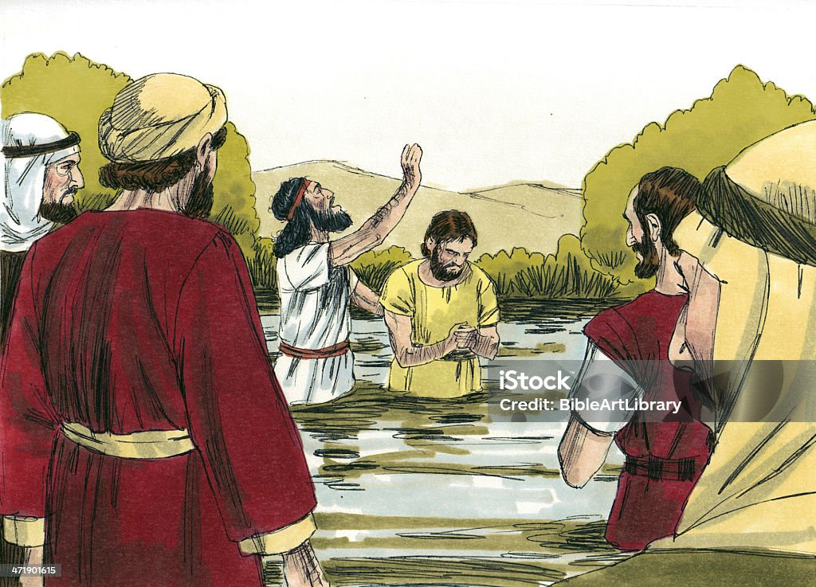
UNDERSTANDING
MATTHEW 11:11
AND
INHERENT LESSONS

Slide 2
“Verily I say unto you, Among them that are born of women there hath not risen a greater than John the Baptist: notwithstanding he that is least in the kingdom of heaven is greater than he.”
What makes John the Baptist the greatest of all born of women?
Before we can correctly answer this question, we need to understand that God's standard for measuring greatness is different from man's standard.

Slide 3
Jer. 9:23-24: “Thus saith the LORD, Let not the wise man glory in his wisdom, neither let the mighty man glory in his might, let not the rich man glory in his riches: But let him that glorieth glory in this, that he understandeth and knoweth me, that I am the LORD which exercise lovingkindness, judgment, and righteousness, in the earth: for in these things I delight, saith the LORD.”
From the above scripture, it is clear that a man's greatness before God is the amount of the knowledge and understanding he has about Him. Therefore, the following are not the reasons John the Baptist is the greatest of all born of women:

Slide 4
1.) GOD’s CHOICE: John was chosen by God to prepare the way for the Lord. Mal 3:1, Isaiah 40:3, Matt 3:3
2.) OLD TESTAMENT PREDICTION: John was one of the few people in history to be predicted in the old testament. Isa 40:3, Mal 3:1
3.) ELIJAH-LIKE QUALITIES: John shared many qualities with Elijah including calling a nation to repentance and rebuking the king. Matt 14:4, Matt 3: 5-6.
4.) Many believed Jesus because of him. John 10:41-42
5.) ASCETIC LIFESTYLE: John lived a life of self denial in the wilderness. Matt 3: 1-4.

Slide 5
The only reason John the Baptist was ranked the greatest of all born of women is because he had more knowledge and understanding of the program of God than others including the prophets. Similarly, What makes the least in the kingdom of heaven greater than John the Baptist?
It is not because:
1.) The least in the kingdom is a son of God. John 1:12
2.) He is under a better and new covenant. Heb 8:6-8

Slide 6
3.) He has the Holyghost inside of him. 1 Cor 3:16
4.) He has power to cast out devils. Mark 16:17
But because he is in the kingdom of heaven that John the Baptist prophesied about and so he has better insight, knowledge and understanding than John the Baptist.
Matt 11:2-3 The question asked by John shows he was limited in understanding of the kingdom of heaven.

Slide 7
LESSONS TO LEARN FROM JOHN THE BAPTIST
1.) He knew his purpose (John 1:6-8): Every believer must know his purpose in the kingdom. Act 1:8
2.) He knew the message he was sent to preach (Matt 3:1-2): Every believer must know the message he is sent to preach. 2 Cor 5:18, 2 Cor 6:17, Matt 25:6
3.) He lived the message he preached (Mark 6:20): Believers must live their message for effective witnessing.

Slide 8
4.) He was steadfast and bold (Matt 14:4): John was bold to defend God's law and rebuke sin at all costs. Believers must learn never to compromise even in the face of death. Matt 16:24-25, John 12:25
5.) He was humble and selfless (Matt 3:11): Believers must learn humility and selflessness from John.
6.) John pointed the people to Jesus and not to himself (John 1:29-37): A great lesson to be learned from John. All the shepherds are to point the sheep to the chief shepherd. 1 Pet. 5:2-4
7.) He fulfilled his purpose: John 10:41-42.

