Slide 1
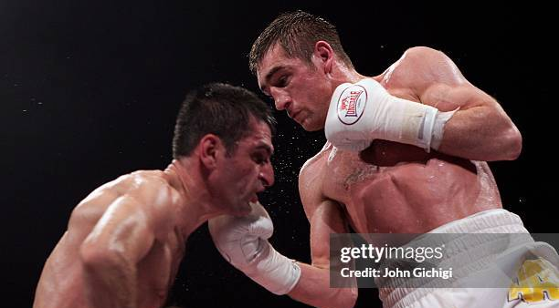
Understanding
God’s Uppercut

Slide 2
Introduction :
Uppercut is a strategy that is used in a combat sport to catch opponents off guard especially when they are trying to attack or defend from a distance
Genesis 3:15
"And I will put enmity between thee and the woman, and between thy seed and her seed; it shall bruise thy head, and thou shalt bruise his heel."
…continued

Slide 3
From this scripture, it is clear that there is a battle between God and Satan. One of the reasons God has always defeated Satan is because of His attribute of fore knowledge, Isa. 46: 9-10, Acts 15:18. His ability to know what the devil is planning in advance put Him in an advantageous position to get ready His uppercut.
God knew the devil will take control of the whole human race through the mystery of iniquity,
(2 Thes. 2:7), He made provision for the mystery of Godliness in advance, (1 Tim. 3:16, Rev 13 : 8, 1 Pet. 1 : 20) to counter Satan's attack.
…continued

Slide 4
So also, God knew Satan will take over the church of the Lord Jesus Christ through the mystery Babylon, the mother of harlots ,
(Rev. 17 : 5, Matt. 13 : 33), He provided for the ministry of restoration (Mark 4 : 26 - 29) (Uppercut). because the gates of hell shall not prevail against the church, (Matthew 16 : 18)
…continued

Slide 5
Gates of hell
Satan Attack
Matthew 16 : 18,
Rev. 6 : 2 - 8.
White horse.
Red horse.
Black horse.
Pale horse.
God's Counterattacks
Rev. 4 : 7
The lion.
The calf
The face as a man
The flying eagle
…continued

Slide 6
The Ministry of Restoration
( God’s Upper Cut)
Mark 4 : 26 - 29
The blade - Justification restored
The ear - sanctification restored
The full corn in the ear - The gifts restored.
…continued

Slide 7
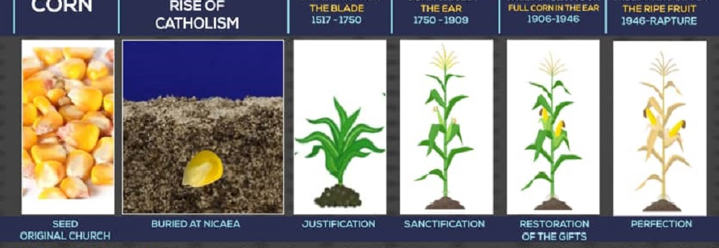
…continued

Slide 8
ADMONITION
Mark 4 : 29
“But when the fruit is brought forth, immediately he putteth in the sickle, because the harvest is come.”
The fruit is brought forth when there is a group of people doing exactly what the church was doing when it was planted.
Mark 13 : 29
"So ye in like manner, when ye shall see these things come to pass, know that it is nigh, even at the doors"

