Slide 1
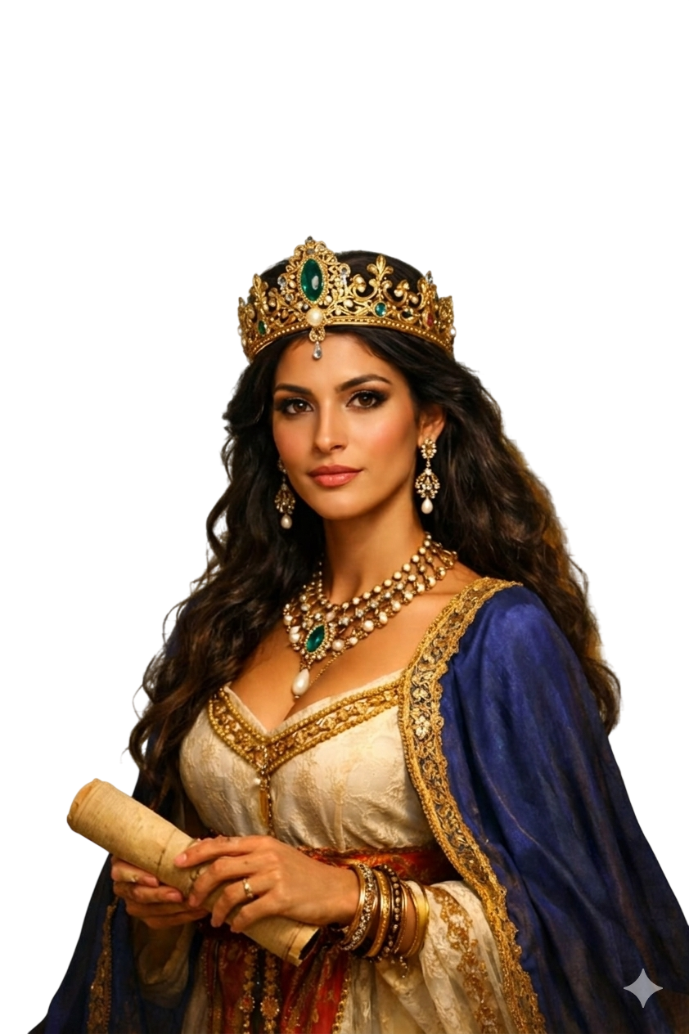
WHO
IS ESTHER?

Slide 2
INTRODUCTION
Text: Esther 1, 2, 3 & 4
Esther is more than a Bible character — she is a revelation of how God lifts the hidden, prepares the chosen, and uses the willing. She was an orphan without status, yet heaven called her royalty. She was unknown in the land, yet God made her unforgettable in destiny. (Esther 4:14)

Slide 3
Esther represents the believer whom God positions quietly before He reveals openly. She is the picture of purity in a corrupt palace, courage in a dangerous moment, and obedience under divine instruction.
“If I perish, I perish.” (Esther 4:16)

Slide 4
She teaches us that destiny is not about comfort — it is about calling. Not about beauty — but about bravery. Not about privilege — but about purpose.
Esther is the voice reminding this generation: God can take you from obscurity to influence, from preparation to manifestation, from hiddenness to impact.

Slide 5
WHO IS ESTHER?
1. Esther - The Predestinated Queen.
(Est. 1:9-12, Est. 2:1, Eph. 1:1-4, Rom. 8:28)

Slide 6
WHO IS ESTHER?
1. Esther - The Predestinated Queen.
(Est. 1:9-12, Est. 2:1, Eph. 1:1-4, Rom. 8:28)
2. Esther - The symbol of purity.
(Esther 1:1-2, Eph 5:26-27, Matthew 5:8)

Slide 7
WHO IS ESTHER?
1. Esther - The Predestinated Queen.
(Est. 1:9-12, Est. 2:1, Eph. 1:1-4, Rom. 8:28)
2. Esther - The symbol of purity.
(Esther 1:1-2, Eph 5:26-27, Matthew 5:8)
3. Esther - The orphan found in strange land. (Esther 2:7, Psalm 75:6-7)

Slide 8
WHO IS ESTHER?
1. Esther - The Predestinated Queen.
(Est. 1:9-12, Est. 2:1, Eph. 1:1-4, Rom. 8:28)
2. Esther - The symbol of purity.
(Esther 1:1-2, Eph 5:26-27, Matthew 5:8)
3. Esther - The orphan found in strange land. (Esther 2:7, Psalm 75:6-7)
4. Esther - The Jewish captive. (Esther 2:6)

Slide 9
WHO IS ESTHER?
1. Esther - The Predestinated Queen.
(Est. 1:9-12, Est. 2:1, Eph. 1:1-4, Rom. 8:28)
2. Esther - The symbol of purity.
(Esther 1:1-2, Eph 5:26-27, Matthew 5:8)
3. Esther - The orphan found in strange land. (Esther 2:7, Psalm 75:6-7)
4. Esther - The Jewish captive. (Esther 2:6)
5. Esther - The Deliverer.
(Esther. 4:14-17, Esther 5:1-8, Proverbs 28:1)

Slide 10
WHO IS ESTHER?
6. Esther - The type of the Bride of Christ.
(Esther 2:15)
  She became queen by election, ordination and grace.
  She born of the word of God.
  She went through her preparation 12 months.

Slide 11
WHO IS ESTHER?
6. Esther - The type of the Bride of Christ.
(Esther 2:15)
  She became queen by election, ordination and grace.
  She born of the word of God.
  She went through her preparation 12 months.
7. Esther - The Bride that cannot be prepared by Shaashgaz. (Esther 2:14, Isaiah 4:1)

Slide 12
CONCLUSION
Esther is more than a historical queen. She is:
A picture of divine election
A symbol of purity
A model of submission
A vessel of deliverance
A reflection of the Bride

Slide 13
Like Esther, the Church is being prepared. Like Esther, the Church must listen. Like Esther, the Church must walk in purity and courage. And like Esther, the Church will stand in a critical hour.

Slide 14
SHALOM!!!

