Slide 1
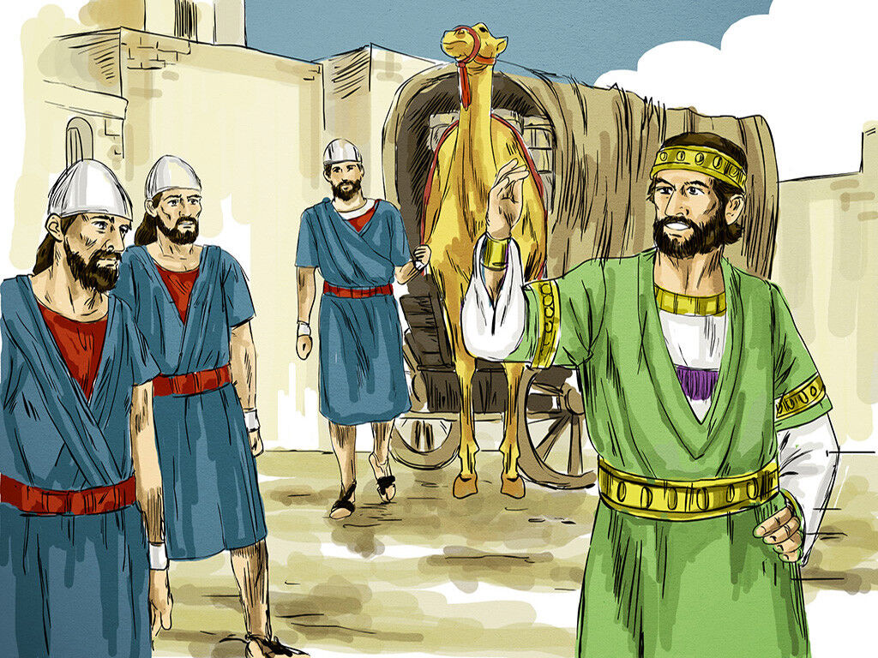
THE ENDTIME
STEWARDS

Slide 2
INTRO:
MATTHEW 24 : 43 – 51,
LUKE 12 : 42 -48
PART 1
These parables are prophecies about the church at the endtime. It is related only to the return of the Lord.
It concerns us and is fulfilling today (Math.24 : 46, 48. Luke 12 : 43)
…continued

Slide 3
Bringing the accounts in Matthew and Luke together we see that there are three categories of ministers (stewards) at the endtime.
Matthew 24: 43-51, Luke 12:42-48

Slide 4
PART 2
THE WISE AND FAITHFUL STEWARD (Matt. 24:45-47, Luke 12:42-44)
They were wise and faithful because they carried out the Lord’s will.
His will was to give his people the meat in due season.
The meat in due season is the word of the hour. Examples: (Rom. 10:3, 2 Tim. 4:2-4, 1 Tim. 4:1-3)
…continued

Slide 5
The wise and faithful stewards were given out the true word of God.
His end shall be Hornor, dominion, he will reign

Slide 6
PART 3
THE EVIL STEWARD (Matt. 24:48-51, Luke 12:45-46)
He did not give the meat in due season
He was smiting the fellow servants (Lording over God’s heritage) 1 Peter 5:1-3
He was eating and drinking with the drunken (worldliness in the church 2 Cor. 6: 14-16)
His end shall be with the unbelievers

Slide 7
PART 4
THE IGNORANT STEWARD (Luke 12 : 48)
Did not know the Lord’s will
Ignorance of God’s word (will) is no excuse (2 Sam. 6:1-9, Matt. 7:21-23, Rom. 10:3)
Salvation is by knowledge – (John 8:32, Rom. 1:17)
The Ignorant shall also be judged.

Slide 8
CONCLUSION
Jude 3, Gal. 1 : 6 - 9
Make sure the stewards feeding you are wise and faithful.

